Slide 1
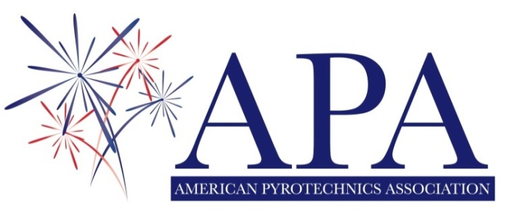

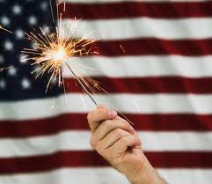
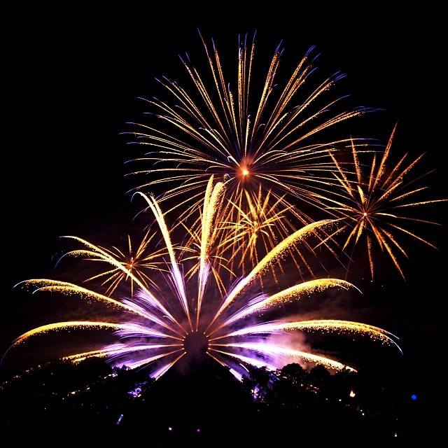
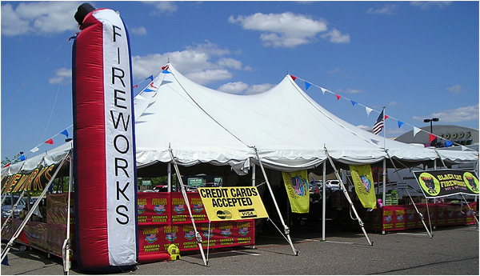
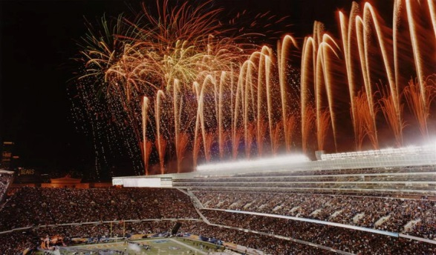
American Pyrotechnics Association
Preserving & Promoting an American Tradition

Slide 2
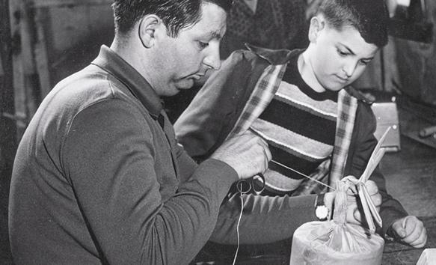
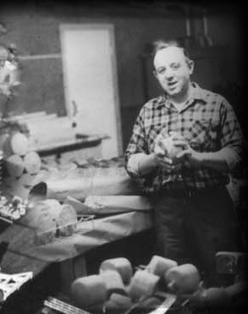
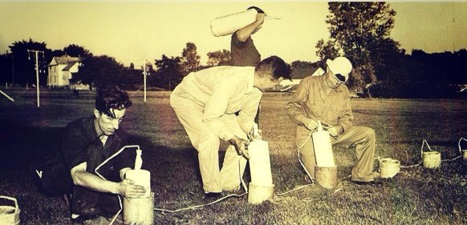
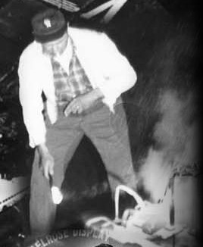
Why APA Was Established
Founded in 1948, the American Pyrotechnics Association was formed by 7 fireworks manufacturing companies who recognized the need to unite in order to effectively address industry-wide issues.

Slide 3

APA Mission
To encourage safety in design and use of all types of fireworks.
To provide industry information and support to its members.
To promote responsible regulation of the fireworks industry.
But the APA is much more….

Slide 4
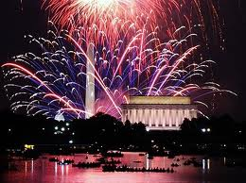
ADVOCACY
The APA is . . .
The APA is the voice of the fireworks industry 365 days a year on Capitol Hill and with key regulatory agencies such as DOT, ATF, and CPSC.

Slide 5
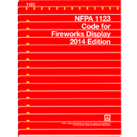
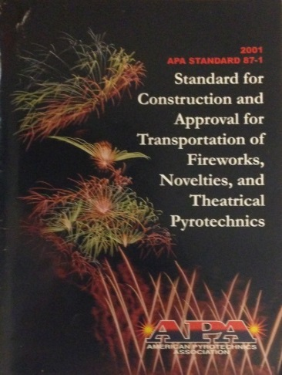
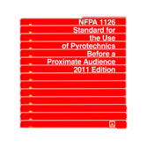
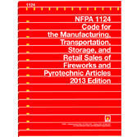

The APA is . . .
CODE & STANDARD DEVELOPMENT
The APA works with code development organizations to ensure that fireworks related codes and standards are not overly burdensome or restrictive on the fireworks industry.

Slide 6
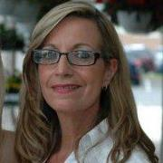
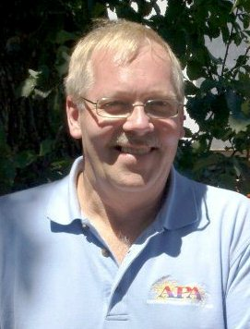
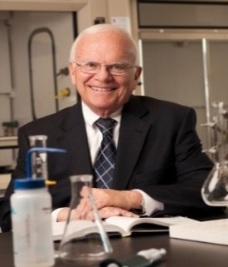


The APA is . . .
COMPLIANCE ASSISTANCE
No single company could match the technical, regulatory & legal expertise offered through the APA staff, consultants & counsel.
Julie L. Heckman, Executive Director
Gregg Smith, Safety Program Manager
Dr. John Conkling, Consultant

Slide 7
The APA is . . .
INDUSTRY FACTS
Injuries in perspective
Fireworks-Related Injury Rates DECLINE
The APA compiles industry statistics and facts, serving as a central information source on regulatory actions and other matters pertaining to the pyrotechnics industry.

Slide 8
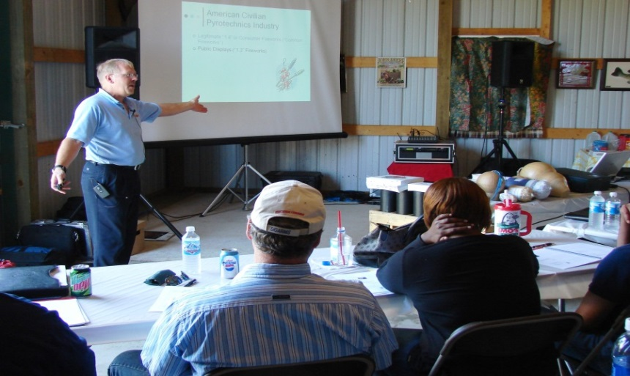
The APA is . . .
EDUCATION & TRAINING
Training industry members to understand & comply with regulatory responsibilities.
Developing educational DVDs, publications & training programs that explain regulations & encourage safety.
Cultivating positive relationships within the enforcement community by serving as a resource for information and training.

Slide 9
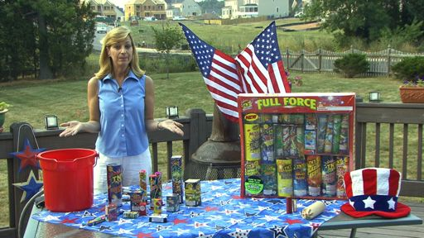
The APA is . . .
PUBLIC RELATIONS
When the media or general public has questions about fireworks, the first call they make is to the APA. By conducting countless interviews each year, APA strengthens the image of the industry and confidence in the safety of its products.

Slide 10
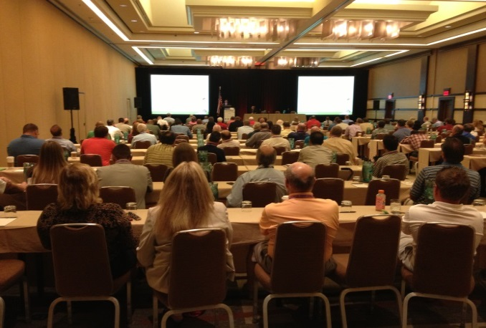
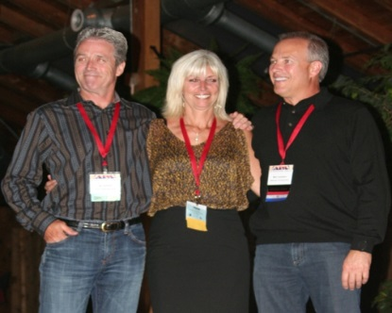
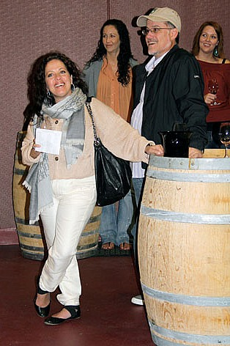
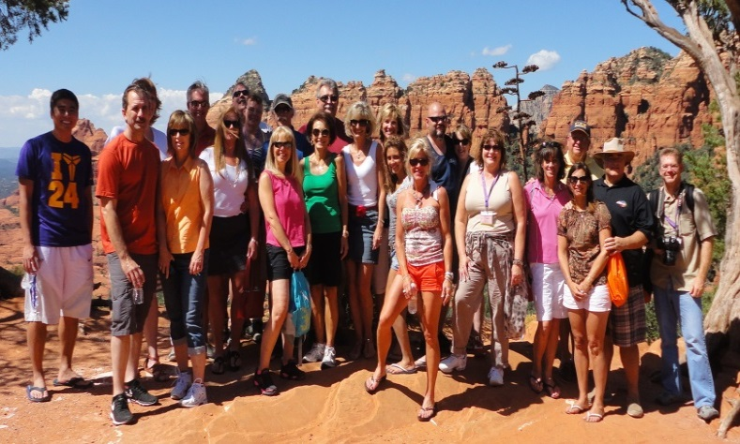
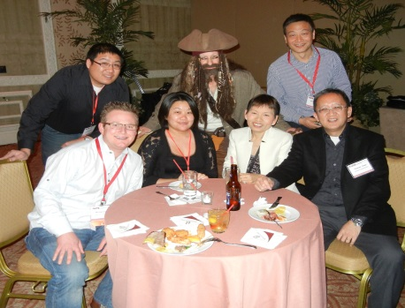
The APA is . . .
NETWORKING
APA meetings and conventions provide forums for interaction with the leaders of the U.S. fireworks industry and unique opportunities for cultivating future business ties.

Slide 11
APA Members
Represent the entire fireworks industry – display & consumer, manufacturer & distributors, domestic & international, companies large and small who share a dedication to safety & compliance.
Did you know? While APA members represent approximately 85% of the U.S. industry,
almost a quarter have gross revenue of less than $250,000 a year?

Slide 12
Membership Categories
Full – Companies with principal place of business in the U.S. for the purpose of
importing, distributing, selling, or manufacturing fireworks. Also includes domestic
companies involved in the design & production of professional fireworks displays.
Commercial User – Theme parks & theatrical productions that are commercial
users of fireworks.
International – Companies with principal offices outside of the U.S. that are
engaged in the manufacture and/or export of fireworks.
Supplier – U.S. or foreign companies that supply materials and/or services to
to the U.S. fireworks industry.
Fire Service- Individuals or entities involved in the inspection, certification or use of
fireworks.

Slide 13
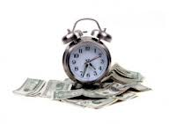
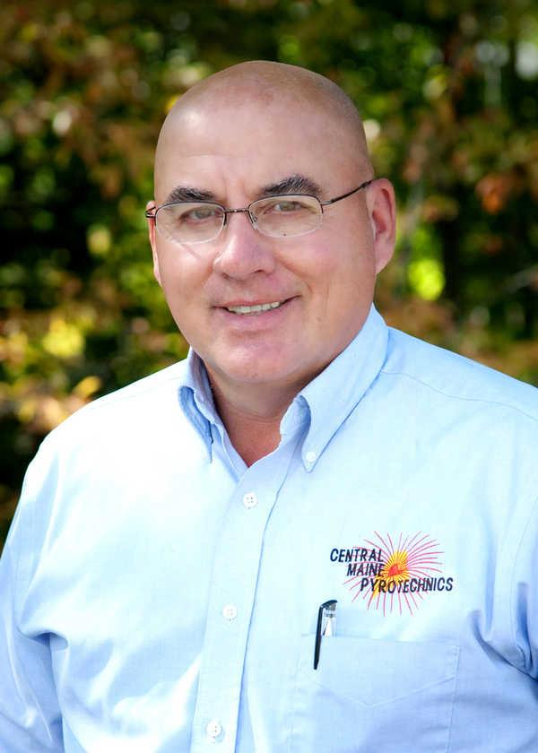
What’s the VALUE?
Membership in the APA saves you time and money, particularly if you are a small or medium sized company.
“Right now I’m not big enough to have a compliance department, but the APA provides me the latest regulatory information and is available as resource for answering questions. Annual dues to the association are far less expensive than one violation penalty.
APA membership is an investment in my company’s future.”
Steve Marson, Central Maine Pyrotechnics, Hallowell, ME

Slide 14
At Work, Year-Round to Assist APA Members
A full time staff in Washington, D.C. with established relationships to Federal officials and agency regulators
This provides members:
Timely updates & communications on new and ever changing regulations.
Access to on-call technical and regulatory compliance assistance.
Opportunities for fireworks specific HazMat, DOT, and OSHA training.
Discounted subscription available for Emergency Response coverage & other training resources.
24/7 technical support & expertise, particularly crisis management assistance.
Troubleshooting unique situations and expediting resolutions.

Slide 15

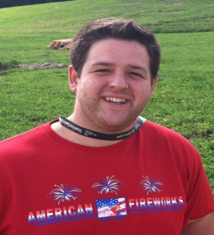
Adding to Your Bottom Line
The complex web of regulations governing the sale & use of fireworks are difficult to navigate & understand. Compliance assistance available through the APA can potentially save your company thousands in costly fines and penalties. The average DOT HazMat violation is $10,000!
“Last year I faced an unexpected DOT audit and the APA staff went above & beyond to help me prepare. Without the guidance APA provided, I don’t think we would have passed with such flying colors.”
Roberto Sorgi, American Fireworks Co., Hudson, OH

Slide 16

Established Ties to Assist with the Unexpected & Expedite Resolutions
“APA’s longstanding relationships with officials in
Washington, D.C. and around the world are invaluable in assisting its members, especially international manufacturers. Whether it’s expediting an EX Approval or dealing with an unexpected shipping issue, the APA staff knows who
best to contact to resolve the issue promptly.”
Jim Shih, Sunny International

Slide 17
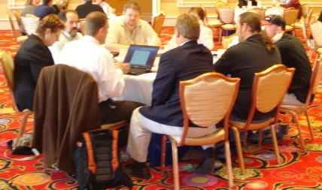
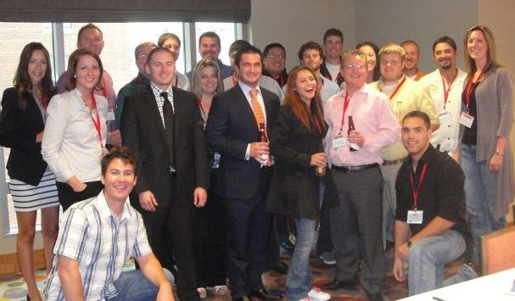
Professional Development Opportunities
Committees
APA Committees and Task Groups provide
forums for members to share their expertise and
collectively work to address common industry problems.
Future Industry Leaders
APA’s Next Generation APA (NGAP) group is one way that younger industry members can receive professional development & guidance to prepare them as leaders for the future.

Slide 18
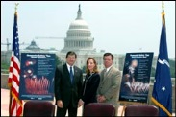
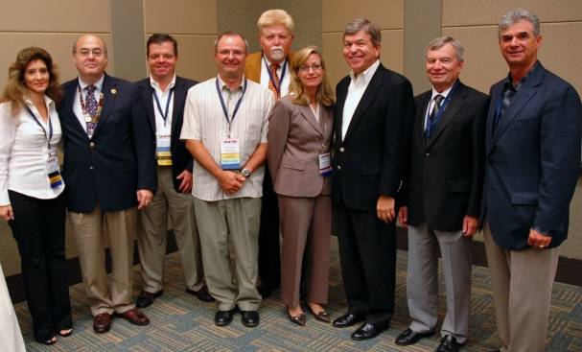
Building Relationships with Policy Makers to Move the Industry Forward
Pressing FMCSA for HMSP reforms & HOS seasonal waivers.
Advocating with PHMSA on need for alternative means of Approval for 1.4G consumer fireworks; and policy clarifications on EX expirations, series Approvals & specialty devices.
Preventing “user fees” for Special Permits & Approvals.
Testifying before Congress on EX Approval backlog.
Alliance with OSHA to promote worker safety.
Partnering with ATF, DHS & OSHA to assess chemical facility safety & security.

Slide 19
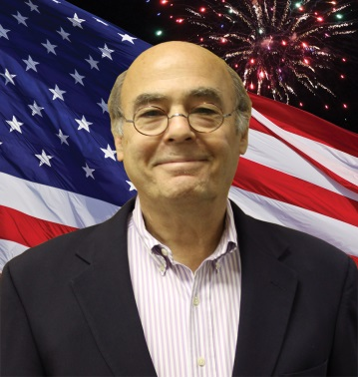
Invest in the Future
For over six decades the APA has worked toward responsible regulation of the fireworks industry and in today’s climate that work has never been more challenging.
Unity and cooperation are critical if the American tradition of celebrating with fireworks is to be preserved.
Join the APA Today
“The APA recognizes the value of working together and
we invite you to join us as we strive to
Preserve, Protect, and Promote fireworks in the U.S.”
William A. Weimer, APA President

