Slide 1

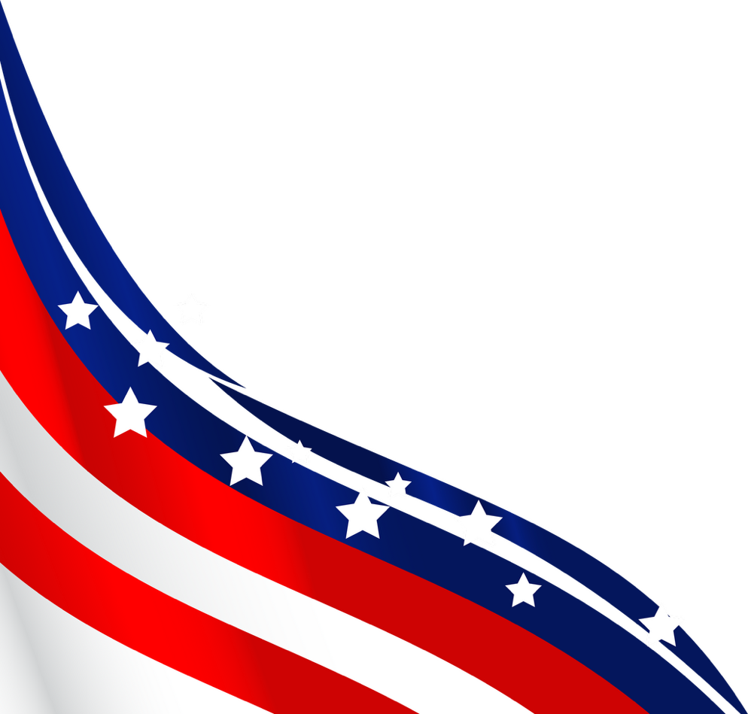
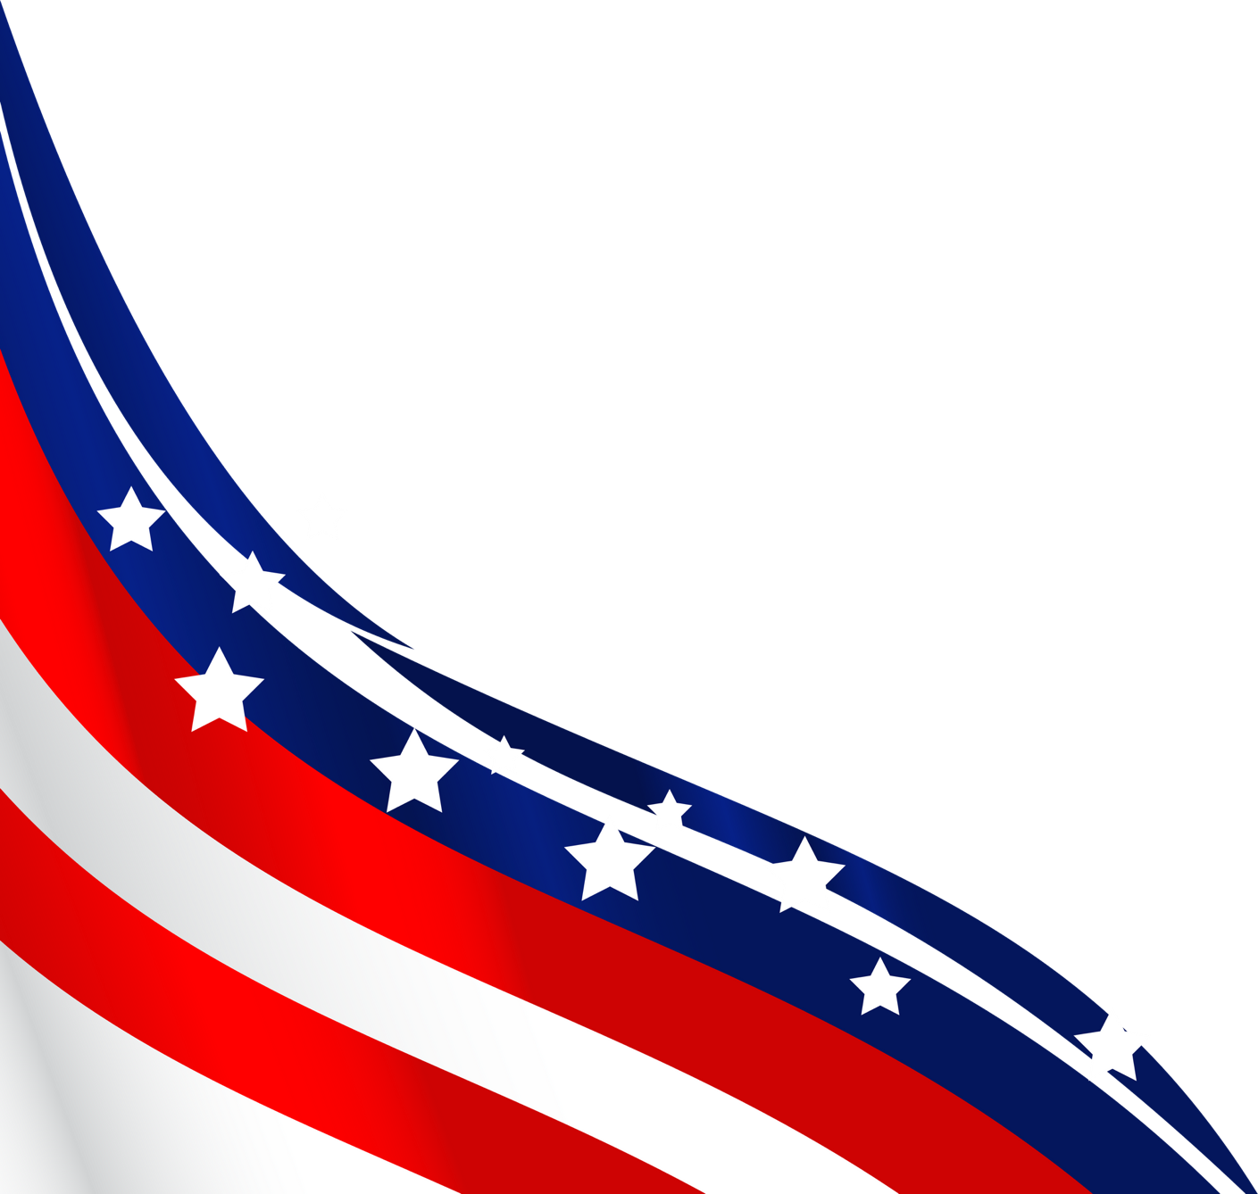
APA
CONFERENCE
Industry Update
James Fuller
ArenaComms

Slide 2
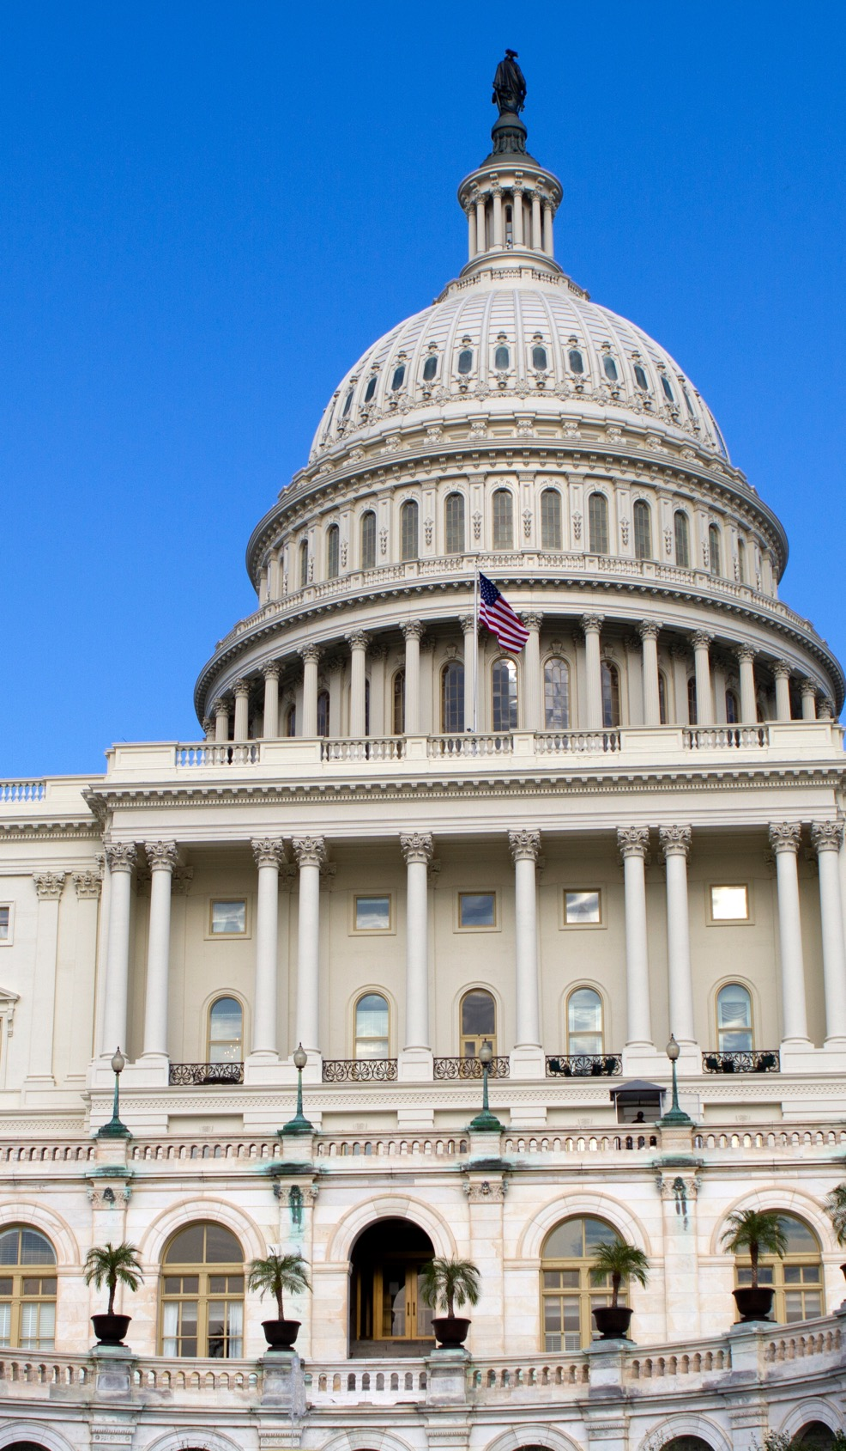

ATF Modernization & Variance Efforts
01
  Conducted multiple meetings with ATF personnel on modernization initiatives.
  Rulemaking process remains stalled
02
  Developed and offered igniters variance opportunity as a potential model for future industry collaboration
03
  Updated the Committee and APA members through communications

Slide 3
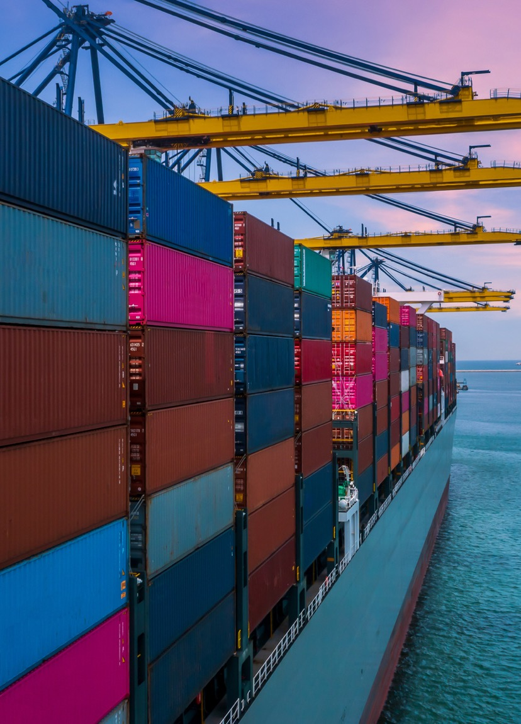

TariffAdvocacy
Supported APA and NFA working group
Messaging
Advocacy
Media
DC trip
Member Communications Support
Support member communications and updates
Developed talking points and FAQs
Media releases
Media engagement and monitoring

Slide 4


Environmental Best Management Practices

Slide 5


Fourth of
July
Preparations

Slide 6


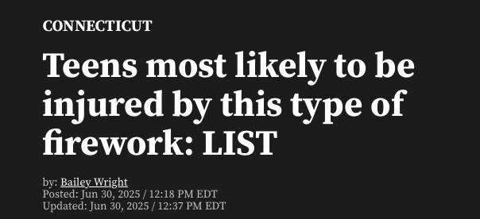
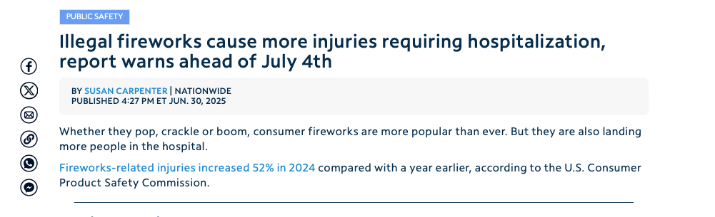
AFSL Injury Report
  Assisted with report finalization
  Drafted media release
  Pitched media on behalf of AFSL
  Conducted interviews
  Positioned AFSL as a “go-to” source for injury data

Slide 7
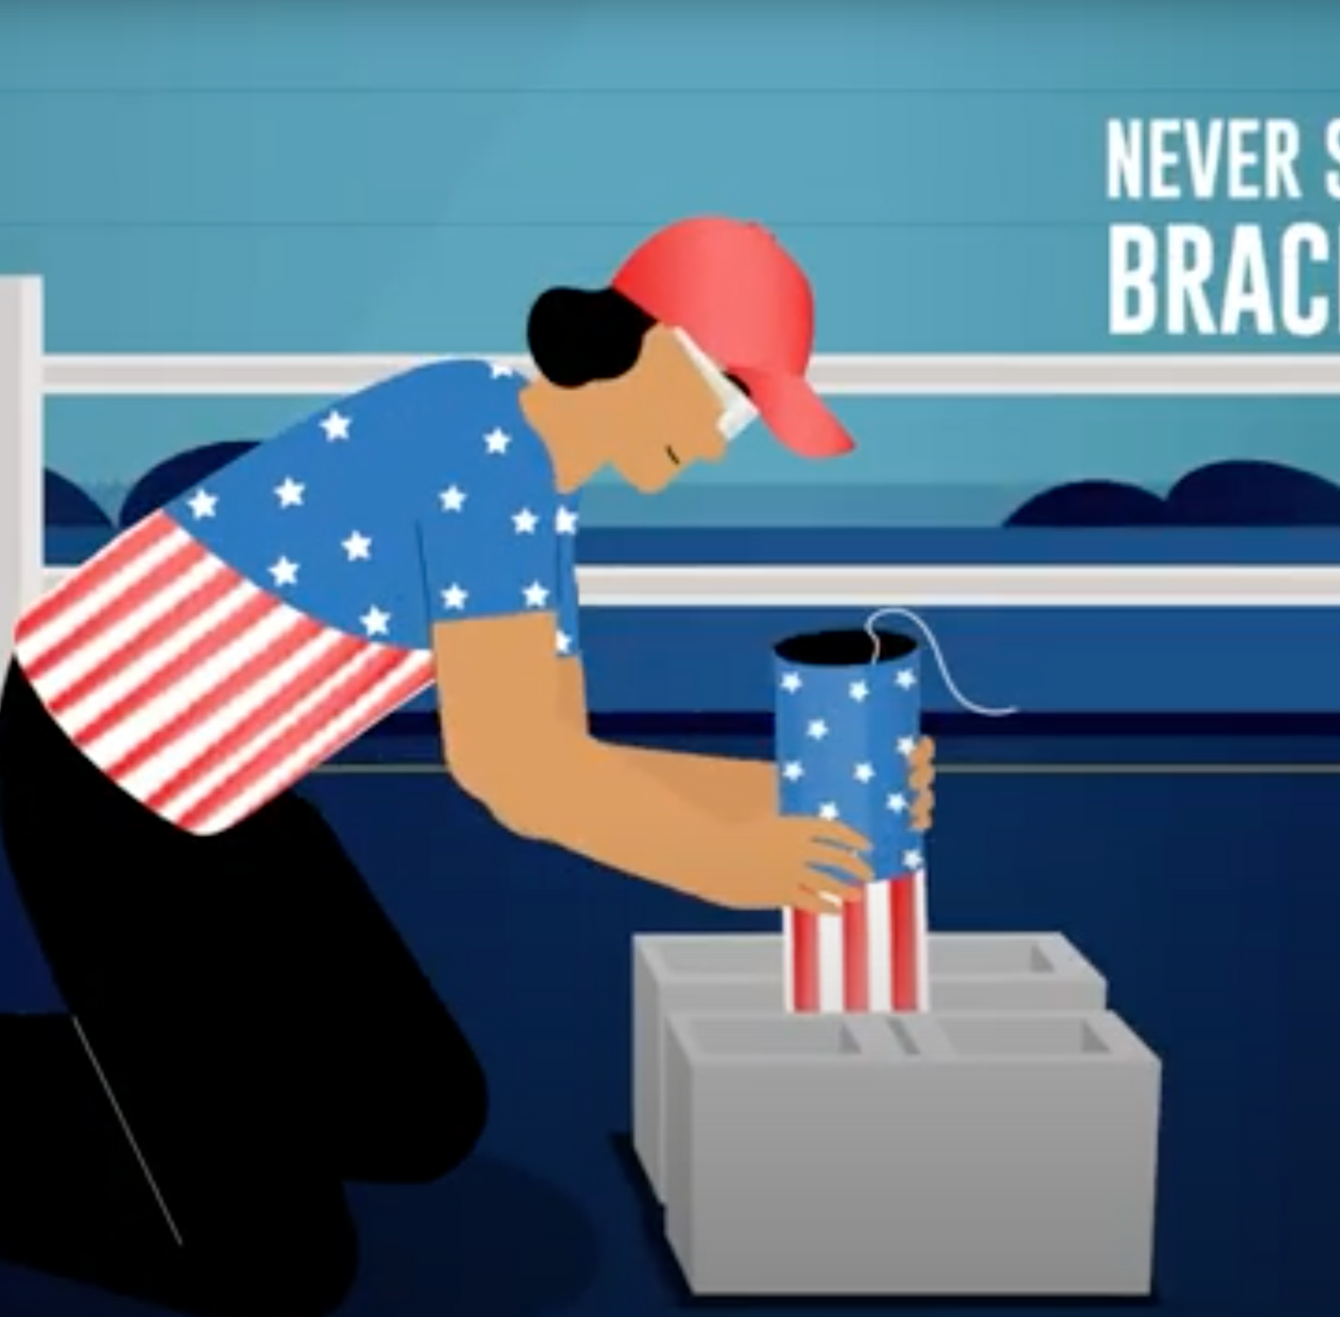

Safety and Education
  Assisted with concepting and scripts of “Don’t be that Guy” animinated video series
  Developed APA media release
  Positioned the series as a cornerstone of 2025 campaign
  Team pitched national broadcast and print outlets

Slide 8

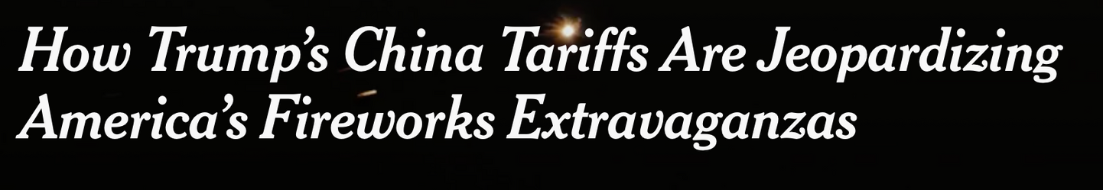


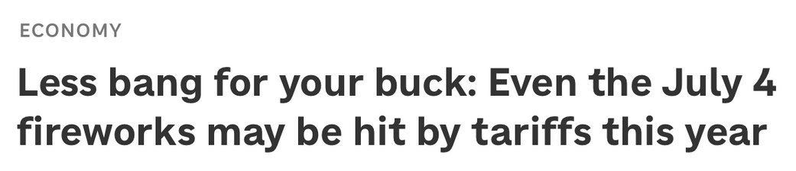
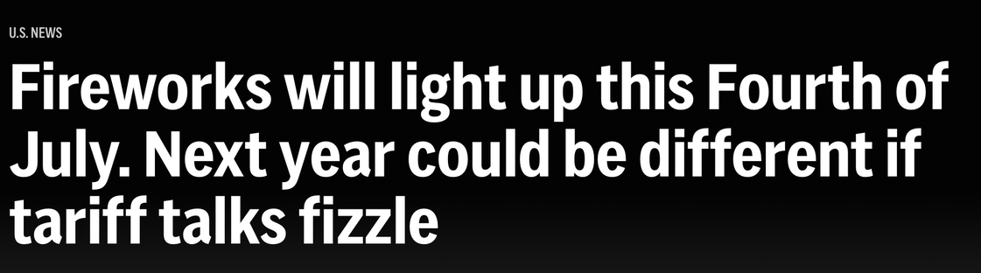
Fireworks Related Media Coverage

Slide 9
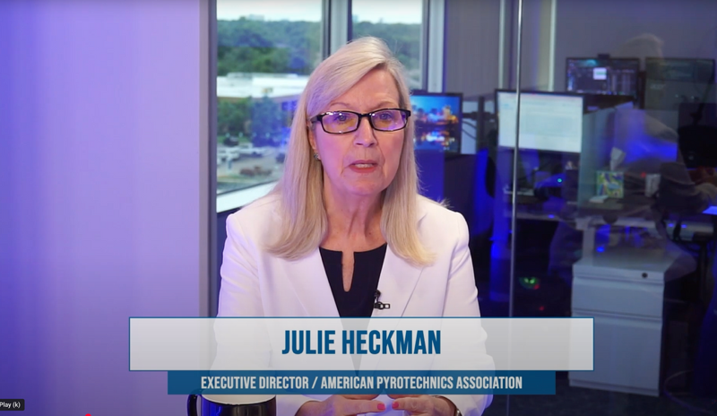
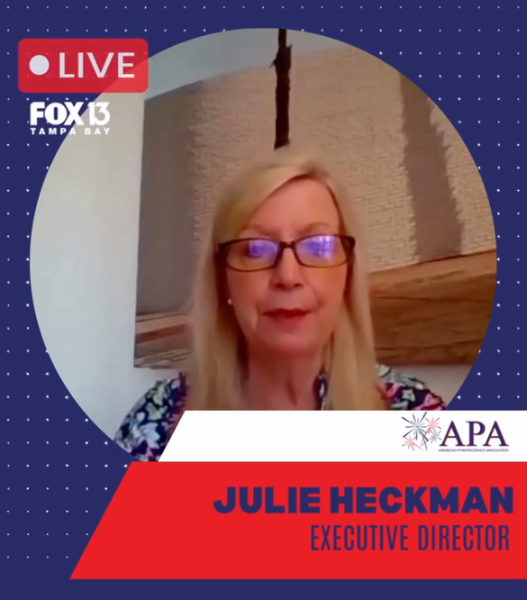
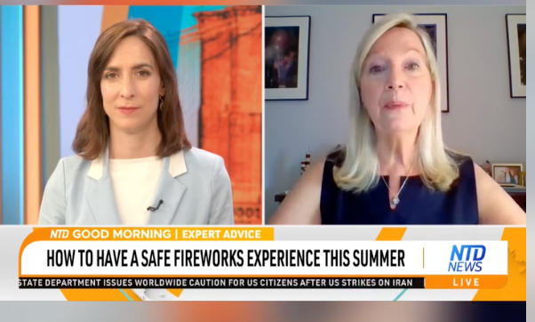
Fireworks Related Media Coverage
The Jeff Crilley Show
NTD TV
Fox - Tampa

Slide 10

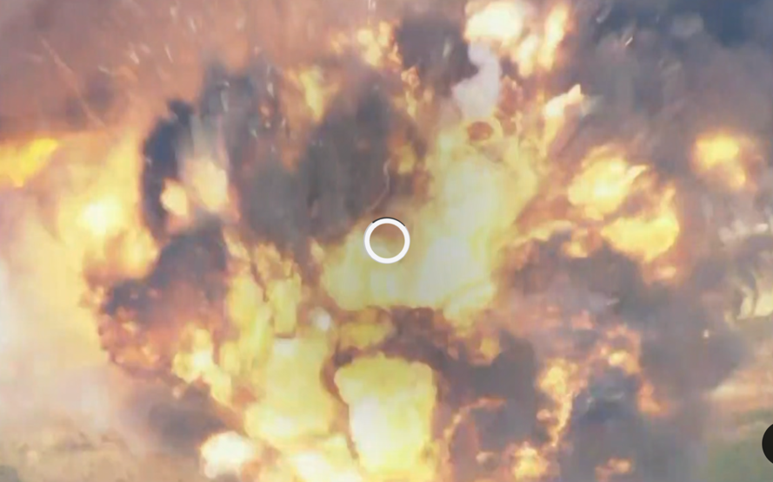
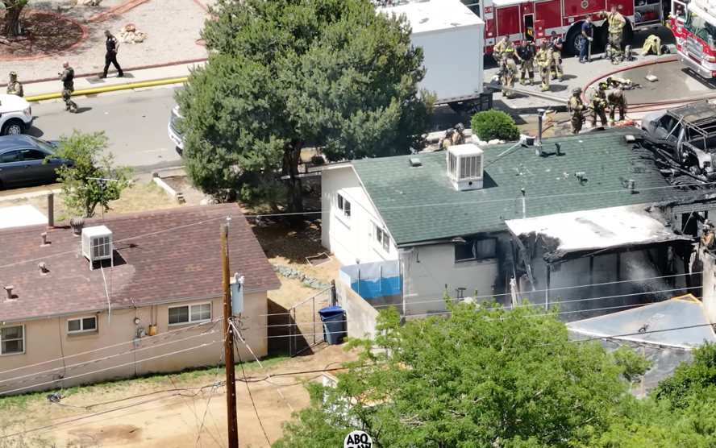
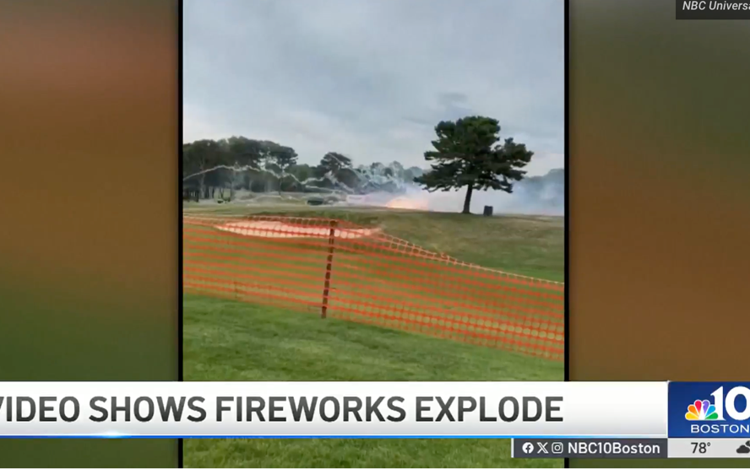
Display Incidents Captured America’s Attention
Fireworks
Explosion Kills Seven in California
Dual House Fire Caused by Fireworks
Two Hospitalized after Fireworks Explosion
California
New Mexico
Massachusetts

Slide 11


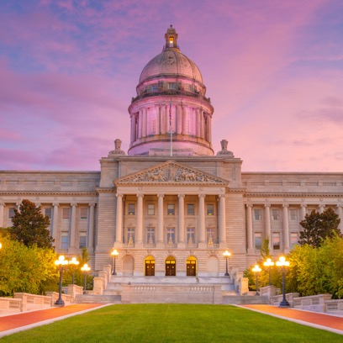

Looking Ahead
Continue to lead the conversation.
Coordinate engagement.
Focus on safety and regulatory compliance.
Planning
Policy
Preparedness
  250th Anniversary
  Policy makers
  Trump Administration
  Regulatory strategy
  Tarrifs
  ATF modernization
  Regulatory compliance
  Local restrictions
  Coordinated industry voice
  Authority on safety and injury data
  Media and incident comms training

