Slide 1
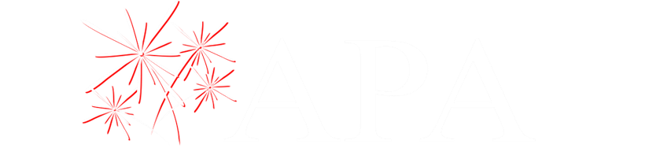
Proximate Pyrotechnics Safety Awareness Project
2025
AmericanPyro.com
Notes:
APA Fire Service Training for Professional Display Sites
Exclusively for the members of the American Pyrotechnics Association
AmericanPyro.com

Slide 2

What is the Project about?
APA has identified growing trends which cause concern for industry:
The use of pyrotechnic articles and fireworks in proximate settings which are not intended for proximate use.
Use of proximate pyrotechnics in a manner not in conformity with established standards.
A need for better implementation of the risk assessment process and application of mitigating controls to reduce risks to acceptable levels.
A need to re-focus industry on the culture of safety and balance it with a need for creativity and competitive design aspirations.
Preventing professional pyrotechnic products from making their way into consumer markets.

Slide 3
Project Update
Final Scripts have been written and approved by the proximate committee
An on-camera spokesperson has been selected- Ramiro Rodriguez from Cal-Fire
Finalizing scheduling with Veverka Brothers and Image Engineering who has offered their facility in Baltimore for filming.

Slide 4
What does the series comprise?
There are a total of 5 videos, Plus an introductory, overview video
Each video is targeted to a different audience allowing for addressing concerns unique to each area.

Slide 5
Video 1- The Corporate Level
This video addresses the disconnect at the corporate level with respect to risk management:
Possible factors contributing to this disconnect:
Lack of knowledge/ Influx of new providers in the marketplace
Creative/competitive drive to produce new & dramatic looks
Cavalier attitude or outright disregard for established standards

Slide 6
Video 2 – Focus on Risk Assesment
The primary difference between traditional displays and proximate displays is the proximity to audiences. And the unique risks posed by each individual venue.
This video reinforces the risk assessment process. And further explains how to examine, evaluate and mitigate risks in proximate environments.
.

Slide 7
Video 3- Decoupling Classification from use
The most common issue we see is that there is an incorrect assumption that if a product is classified as UN 0431 That it is, by default, a close proximity device.
This is not the case!
Many products produce fallout or debris which could be hazardous.
This video stresses the differences between different classes of product, and the importance of product testing and selection

Slide 8
Video 4- Code Callouts
Even when true proximate products are being used, they are sometimes used inappropriately.
This video focuses on the most important provisions of the codes which govern the use of products in close proximity applications.

Slide 9
Video 5- Summary of Resources
The final video in the series provides several key resources for companies, operators and AHJ’s alike.
Includes websites containing regulatory resources.
Links to APA checklists.
Links to other foundation Safety Resources.

Slide 10
A Quick Refresher on Separation distances
We would like to take a moment to briefly remind people of how separation distances work in proximate applications.

Slide 11
NFPA 1126 Standards.
Since its initial creation in 1992, NFPA 1126- Standard for Use of Pyrotechnics Before a Proximate Audience - has served as a guideline for the safe use of pyrotechnics at distances less than those specified in NFPA 1123.
Principally, the standard establishes requirements for what constitutes a safe use of product before proximate audiences. (closer than the 75’ minimums for low hazard devices set forth in NFPA 1123):
Distance from spectators (closer than the 75’ minimums for low hazard devices in 1123)
Safe Firing trajectories
Firing safeguards
Standards for evaluation of the suitability of effects for proximate use.

Slide 12

NFPA 1126 Highlights
Product separated by 15’ or two times the fallout radius of the product, whichever is greater
Trajectories of product shall not be fired over audience areas
All products must be evaluated for performance to confirm suitability of its intended application

Slide 13
How is minimum distance calculated?
When considering fallout radius under NFPA 1126:
Consider the diameter of the functioning device in a vertical position.
Add any additional distance to allow for angles and even wind if relevant.
For Example:
A 20’ high gerb angled 50 degrees from vertical- Now is traveling nearly 20’ laterally- so the proper fallout distance would be 20’ x 2 or 40’ in the direction of travel.
Consider a 30 mm bombette (shell) If the normal functioning diameter of the effect is 45’ in diameter. The Safe distance would be 45’ x 2 = 90’. NFPA 1123 default distance would default 84’

Slide 14
Not every venue is the same!
Just because a particular product works in one venue. Does not mean it will work in the next.
It might be necessary to have multiple show configurations to accommodate different venues.
Let’s take the following example:
A large-scale aerial device which requires a 150’ fallout area.

Slide 15
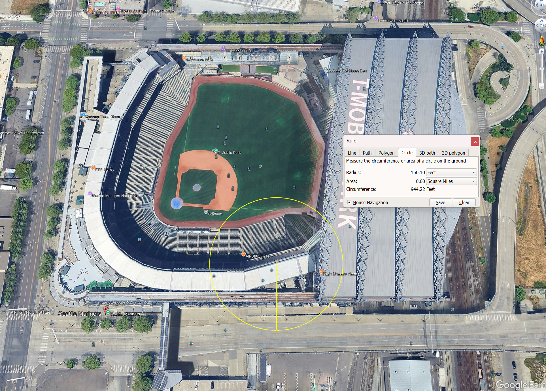

Slide 16
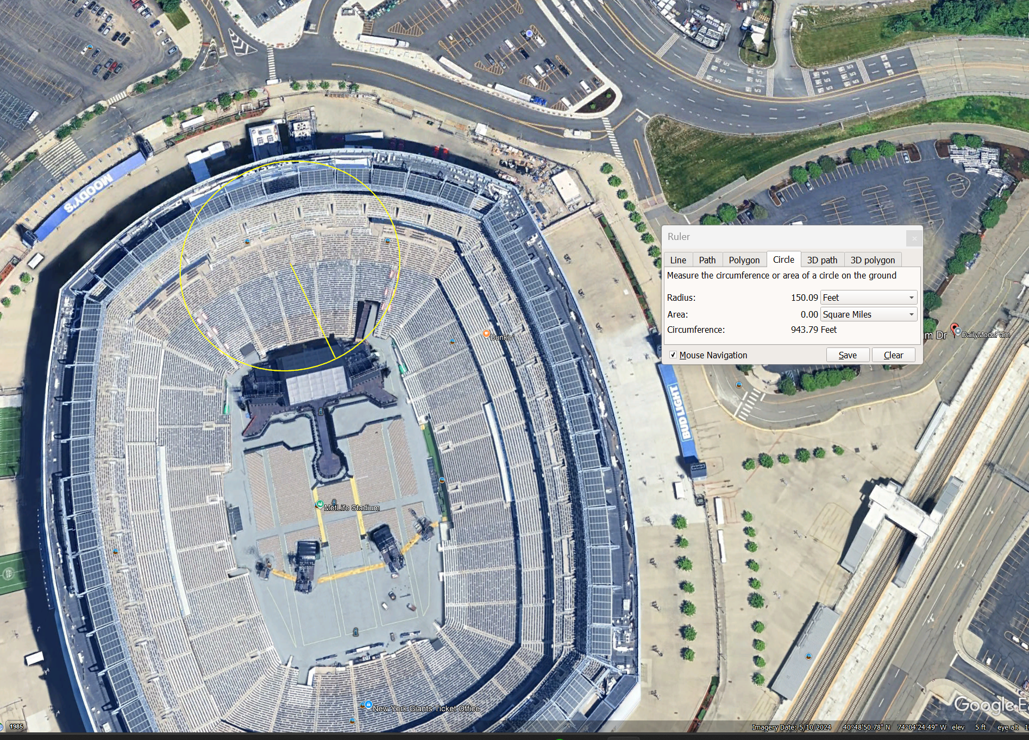

Slide 17

Questions?
This Photo by Unknown Author is licensed under CC BY-SA-NC

