Slide 1

2025 APA Annual Conference
APA at work for you!
September 26, 2025

Slide 2

Practical and Effective Solutions
HazMat Safety Consulting is in the business of regulatory navigation and compliance innovation. Our expertise is dangerous goods consulting.
We provide complex, yet practical and effective solutions, based on insider regulatory knowledge and proven experience, in the safe and compliant movement of hazardous materials and innovative products.

Slide 3
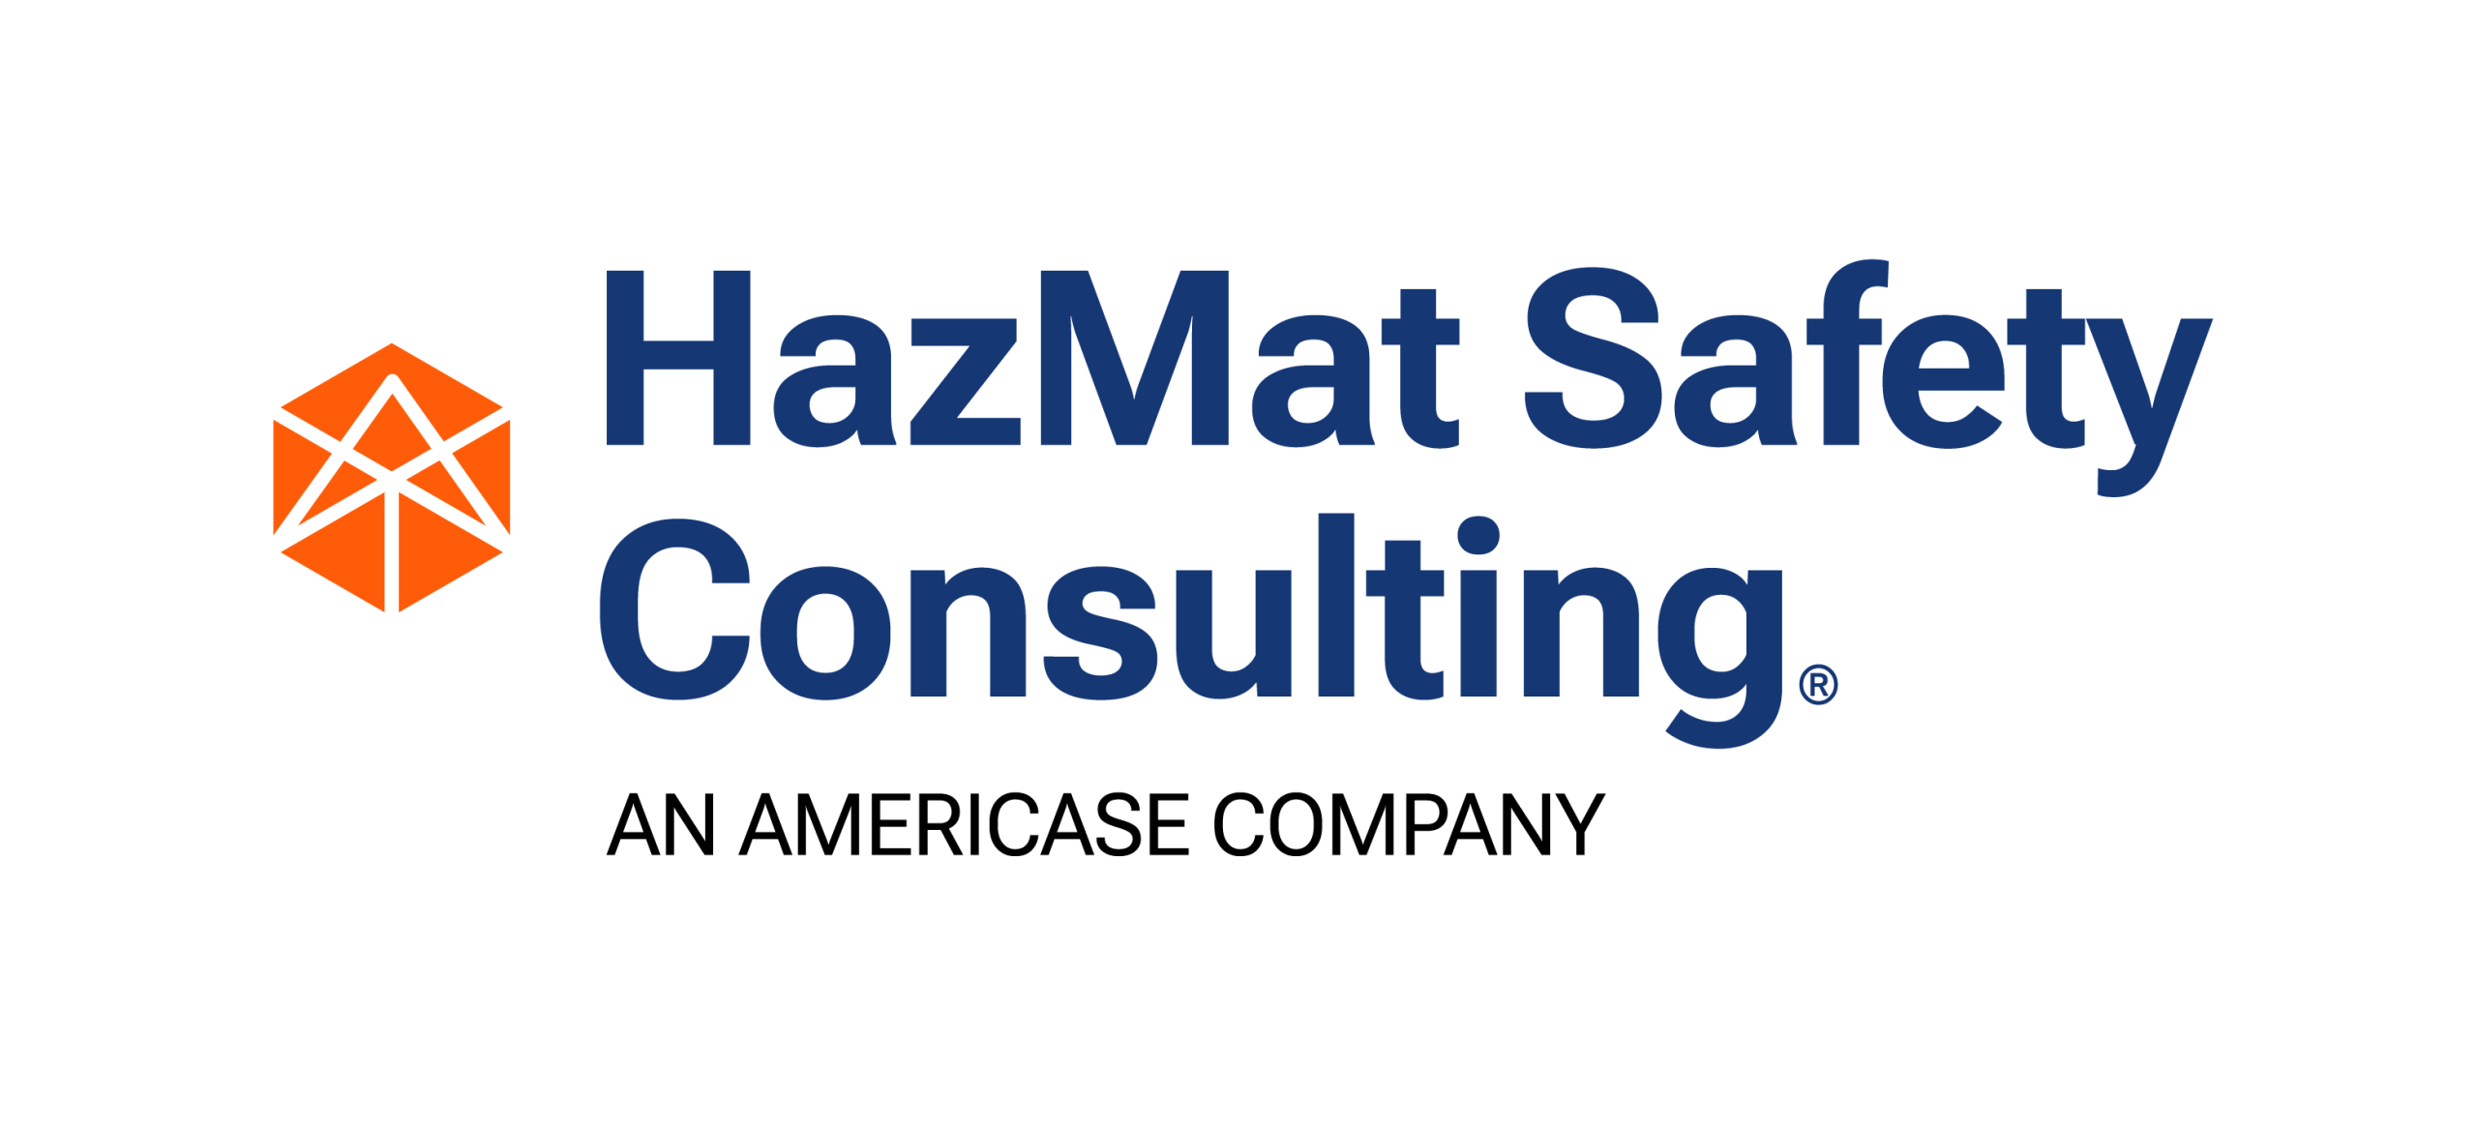
Who We Are
A team of former regulators and industry practitioners that provide our customers confidence and solutions that work within their operations and future vision.
President Ryan Paquet, PG | Vice President Bob Richard
Former USDOT Director of Approvals and Permits and delegate to the UN Subcommittee of Experts | Former Assoc. Administrator of Hazmat Safety with USDOT. Former Chairman of the UN Subcommittee of Experts Former ICAO-TI Panel Member for the USA.
Senior Consultant Mike Pagel | Senior Consultant Duane Pfund
Former USDOT Regulatory Specialist Executive Director of the Medical Device Transport Council | Former Assoc. Administrator of Hazmat Safety with USDOT. Former Chairman of the UN Subcommittee of Experts Former ICAO-TI Panel Member for the USA.

Slide 4
Who We Are
Senior Associate Consultant Michael Roldan | Senior Associate Consultant / Engineer Barbara Lantry-Miller | Senior Associate Consultant Chemist Dr. Richard D Tarr | Senior Associate Consultant Auditor Margaret (Peg) Carson
Former Chief USCG Chief of Hazmat Operations | 30+ years of experience in the chemical industry as Director of Controlled Products and Dangerous Goods for the AMERICAS for Givaudan | Chemist specializing in energetic materials with 30+ years classifying explosives with USDOT. | 14+ Years as a USDOT Hazardous Materials Investigator and 24 years with Massachusetts Dept. of Environmental Protection.
Associate Consultant Adult Learning Paula Reavis | Associate Consultant Compliance Randy Walker | Associate Consultant Mike Van Ort | Associate Consultant Risk Management Paul Stancil
Specializing in adult learning, Paula has been performing DG training for years including courses on US HMR, ICAO-TI, IMDG Code. | 30+ Years of experience in compliance and logistics including leading operations at Oak Ridge and Sandia National Laboratories, including radioactive materials. | 30+ Years as the Dangerous Goods Administrator at 3M and Abbott Laboratories | Former Senior Hazardous Materials Accident Investigator for the US National Transportation Safety Bureau.

Slide 5
APA at Work For You
APA 87-1 A & C – Drafted and submitted petition
PHMSA’s Regulatory Sprint – Drafted and submitted comments on:
- FCA increased Authority
- Definition of Aerosol
- SP Expiration Date
FCA Special Permit request
HM257A – Drafted and submitted comments on deregulatory action for low-hazard ground effects and novelties
Aerosol Can recycling SP-21433
Represented APA at the UN Subcommittee of Experts for the Transport of Dangerous Goods
- Energetics Working Group
- PHMSA Proposal for divisions in Class 9

Slide 6
APA at Work For You – Still to Come
APA 87-1 B – Drafting
Regulator Watch – Future rulemakings and correspondence
Representing APA at the UN
Subcommittee of Experts for the Transport of Dangerous Goods
- Energetics Working Group
- PHMSA Proposal for divisions in Class 9
Petition for Rulemaking for HOS Exception – FMCSA
Work with IP on PHMSA Reauthorization
Continued work on China and UN0431
Work with APA U on Hazmat courses (in person and online)

Slide 7
Ryan F Paquet, PG RPAQUET@HAZMATSAFETY.COM WWW.HAZMATSAFETY.COM 401-222-0412
THANK YOU!!

