Slide 1


An online training platform for members of the American Pyrotechnics Association

Slide 2
90+ Courses Available
APA Display Operator Training
10 Module Course
APA Driver Training
APA Transportation Manager Training
Hazmat Endorsement Renewal

Slide 3

ELDT Hazardous Materials Endorsement
Free to all APA Members
Great Tool for Hazmat Renewal
Improves Driver Preparation for CMV Endorsement Testing

Slide 4
Over 40 Resources Available
2025 Hazardous Materials Registration Information
Data Q Analyst Guide
Recommended Annual Trainings
Display Crew Safety Briefing
Driver Qualification File Checklist
OSHA Forms for Recording Work Related Injuries (300 & 300A)
OSHA Inspection Process Video
Safety and Health Program Audit Tool
Transportation Site Security Plan Template
FMCSA Safety Audit Guidebook

Slide 5

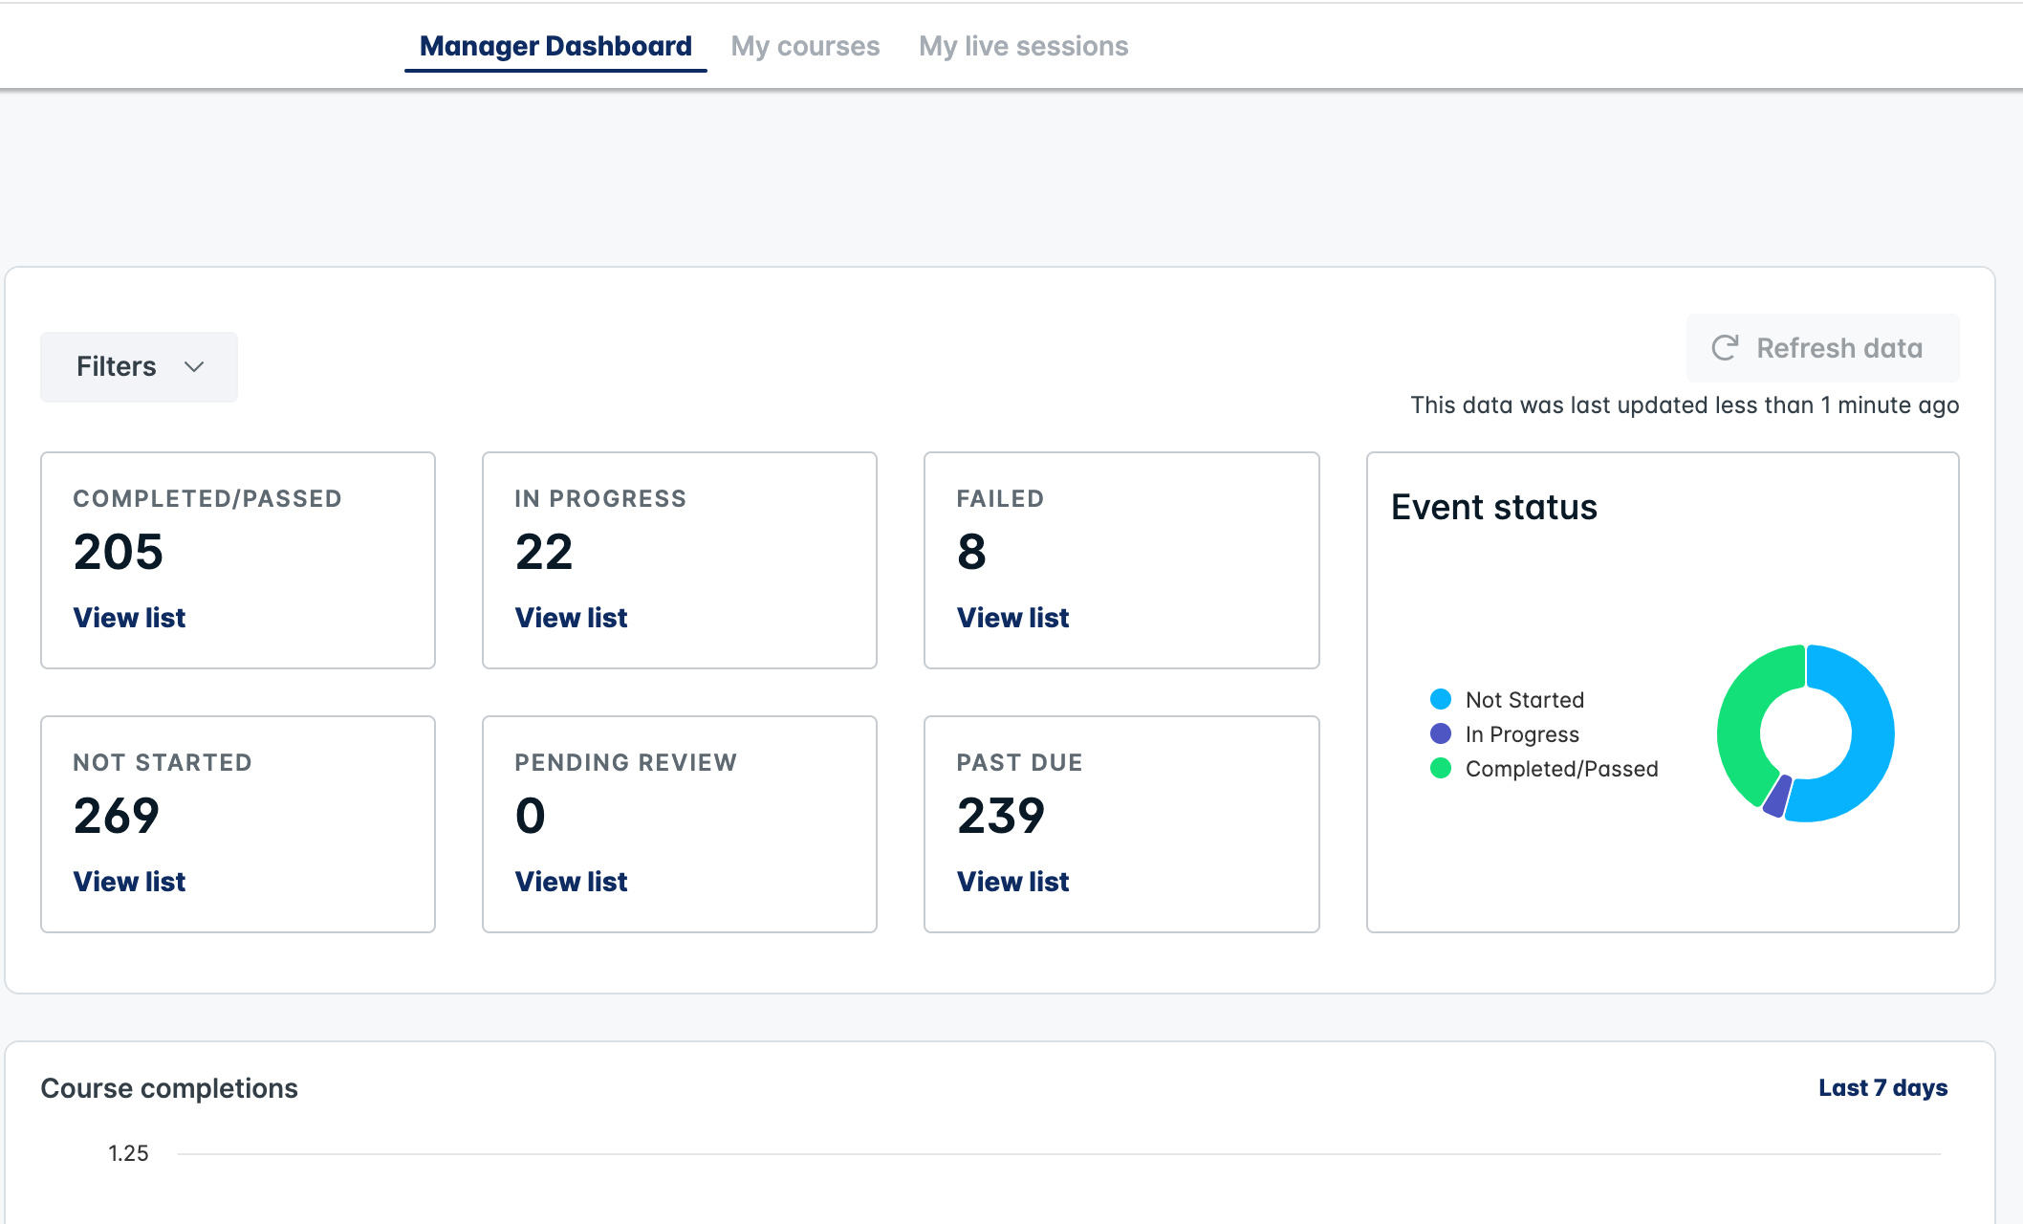
Manager Dashboard
Allows managers to pull reports directly from their home screen, but also to send reminders out to “learners” who are due for updated training.

Slide 6

Creation of manual for training managers
This is a quick reference guide on how to enroll employees
Reminders for those that need to be re-enrolled for training

Slide 7
course updates coming for 2025
APA CDL Driver Training Update (in progress)
APA Display Operator Training Update (in progress)
NEW - APA Display Operator Training for Professional Use Only products (in progress)
NEW - AHJ Display Operations Training (in progress)
Additional Resources

Slide 8

New Courses To Come
Suspended Scaffolding Safety
Understanding the HazCom Final Rule
Dealing with the Media in Emergency Situations
Safety Data Sheets in HAZWOPER Environments
Backing Basics and ”Alley” Dock” Backing and Parking
Backing Basics and Straight Line, Offset and Parallel Parking

Slide 9

We continue to receive calls for assistance with audit preparation, training and risk assessments.
Any members needing additional assistance please contact us.

Slide 10
Thank you!
Please feel free to contact us with any questions to Katherine or Steve
Katherine@AmeriSafety.com
Spelkey@AmeriSafety.com

