Slide 1
PHMSA Regulatory Update
Office of Hazardous Materials Safety | September 2025

Slide 2
PHMSA Leadership

Slide 3



PHMSA Leadership
Ben Kochman – Acting Administrator
Keith Coyle –
Chief Counsel
Emily Wong –
Director of Governmental, International, and Public Affairs

Slide 4
Key Executive Orders
Unleashing Prosperity Through Deregulation (EO 14192)
Unleashing American
Energy (EO 14154)
Deregulation mandate ​(10 for 1)​
Net negative cost requirements​
Focused regulatory analysis of
cost-benefit and justification
Swift approval and construction ​of energy infrastructure permitting​
Expand domestic energy production​
Secure national energy independence​
Repeal of climate-centric
risk assessments​
Critical mineral and mining expansion

Slide 5
Rulemaking Priorities

Slide 6
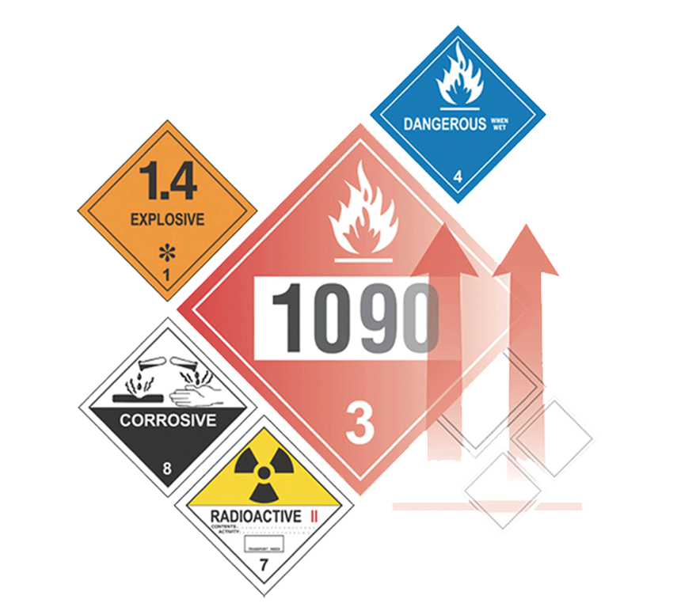
Reducing Regulatory Burdens
In April 2025, DOT’s Office of the Secretary issued an RFI under the Unleashing American Energy initiative, seeking input on regulations or guidance to repeal or modify to cut costs and improve efficiency while maintaining safety. Comments closed May 5, 2025, with ongoing submissions accepted.
ANPRM (HM-265B): PHMSA solicited feedback on whether to repeal or amend any HMR requirements—including guidance documents and special permits—to improve efficiency, reduce unnecessary burdens, and consider elevating well-used special permits into the regulations. Comments closed August 4, 2025.

Slide 7

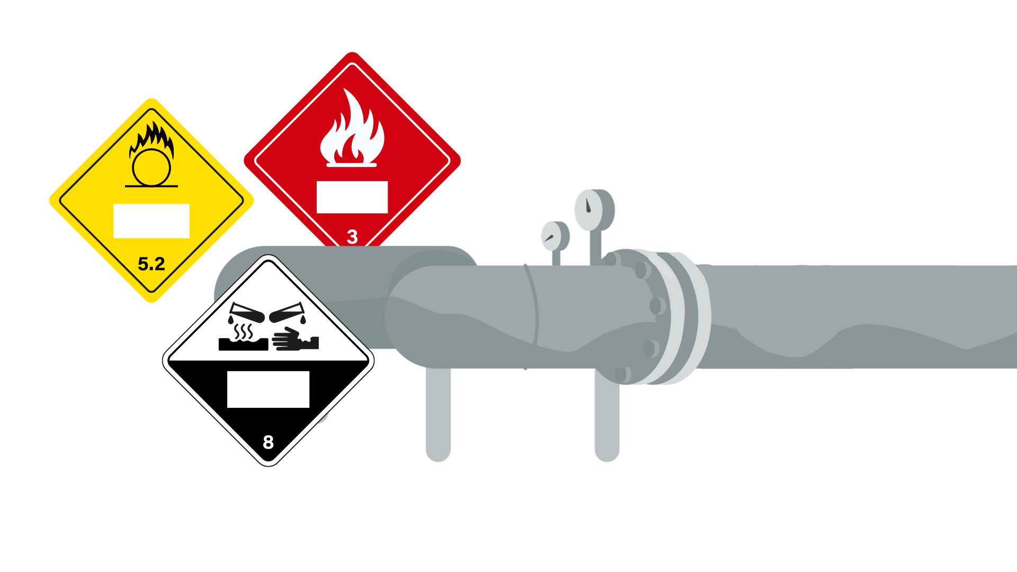
HM-268(A-Q) – Deregulatory NPRMs​
July 1, 2025 – PHMSA published 17 new Notice of Proposed Rulemakings (NPRMs) in the Federal Register.
NPRMs are part of a DOT-led effort to eliminate outdated, unnecessary, and overly burdensome regulatory requirements within the Hazardous Materials Regulations (HMR).
Comment period closed on September 2, 2025.

Slide 8
Rulemaking Actions
Advance Notice of Proposed Rulemakings
Final Rulemakings
HM-224J – Improving the Safety of Transporting Damaged, Defective, or Recalled Lithium Cells or Batteries
HM-266 – Modernizing Regulations to Facilitate Transportation of Hazmat Using Highly Automated Transportation Systems
HM-267 – Modernizing Regulations to Facilitate Transportation of Spacecraft and Space Related Hazardous Materials​
HM-265B – Mandatory Regulatory Review to Unleash American Energy and Improve Government Efficiency
HM-241 – Incorporation of ASME Code Section XII and the National Board Inspection Code​
HM-265 – Eliminating Unnecessary Burdens on Fuel Transportation
HM-250A – Compatibility with the Regulations of the International Atomic Energy Agency
HM-257A – Streamlining Requirements for the Approval of Certain Energetic Materials
HM-208J – Adjusting Registration and Fee Assessment Program (withdrawal)

Slide 9
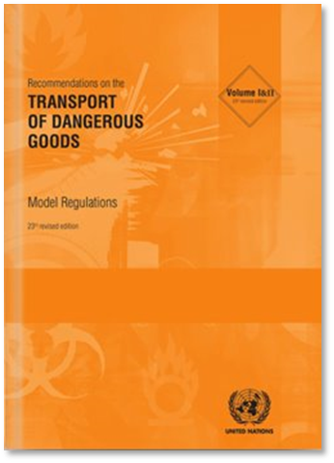


On-Going Rulemakings
Rulemaking Actions Con’t…
HM-219E – Modernizing Regulatory Requirements and Responding to Stakeholder Petitions​
HM-215R – Harmonization with International Standards
HM-215S – Harmonization with International Standards
HM-233G – Continued Conversion of Special Permits
HM-265A – Streamlining and Modernizing Regulations to Improve Safety and Efficiency

Slide 10
OHMS Initiatives

Slide 11
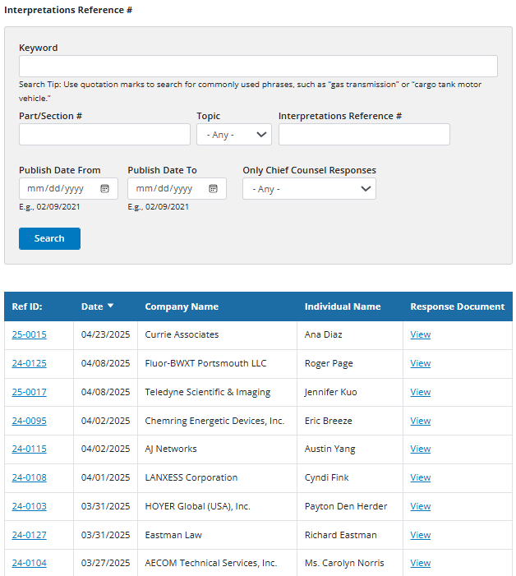

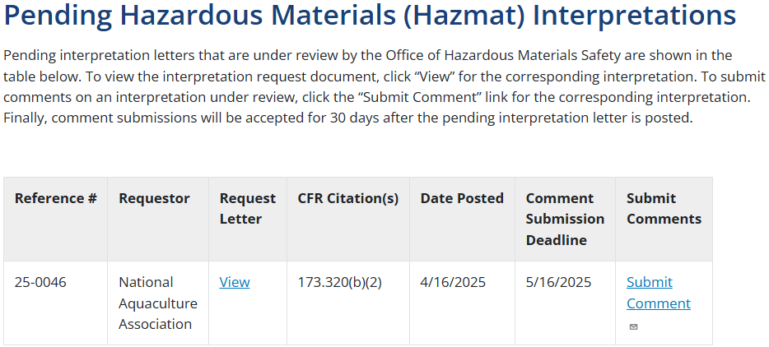
Enhanced Transparency of Interpretation Process
Letters of Interpretation | PHMSA
Pending Hazardous Materials (Hazmat) Interpretations

Slide 12
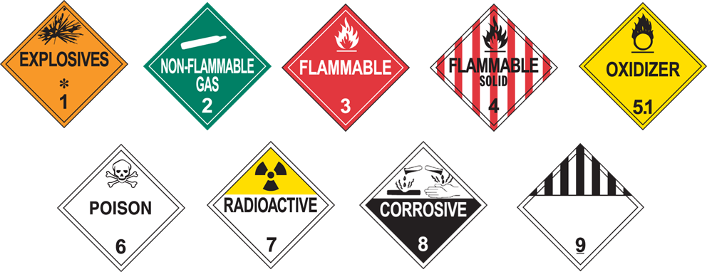


New and Upcoming Initiatives
Final Mile
Delivery Exceptions
(DOT SP 21427)​
UAS Deliveries
Electronic Hazard Communication
Surface Transportation Reauthorization

Slide 13

Questions??
Hazardous Matters is PHMSA's quarterly newsletter for hazardous materials safety.
Every quarter, this publication consolidates timely information on our latest rulemaking activities, upcoming workshops and webinars, newest publications, and other highlights from PHMSA's current safety initiatives.

