Slide 1
ATF Update
American Pyrotechnics Association
Annual Meeting & Conference
September 25, 2025
Indian Wells, California

Slide 2
Overview
Rulemaking Updates
Modernization
Bulk Salute Testing
Licensing Updates

Slide 3
Rulemaking Updates
Safe Explosives Act (SEA) of 2002 – Final Rule
Operating under two Interim Final Rules since 2003!!
Annual Reporting of Explosives Storage to the Local Fire Authority (ARE) – Final Rule
Both Final Rules have been submitted to the DOJ for review and final approval

Slide 4
Rulemaking Updates
Additional regulations are being evaluated for rulemaking pertaining to:
“Traveling” Clearances for Responsible Persons and Employee Possessors
Consolidation/Update to regulations at 555.212, 555.214 and 555.215.
Elimination of type 3 magazines

Slide 5
Explosives Regulations Modernization
Modernization project began in October 2022
Consulted with various industry associations throughout the process (NSAA, ISEE, IME, APA)
Purposes of modernization:
Address outdated references and processes
Clarify areas of confusion
Improve traceability
Introduce new standards to accommodate new processes

Slide 6
Explosives Regulations Modernization
Licensing/Permitting
Current system contains various license/permit types
Moving to one license type, one permit type to simplify application and minimize number of licenses/permits required
Rely on additional fields for statistics/description
No relaxation in public safety measures (background checks, storage, proof of licensing/permitting)
One license usually will cover satellite locations operated by a central office

Slide 7
Explosives Regulations Modernization
Recordkeeping
Current requirements are different depending on the type of license or permit
Create consistency for all types of businesses (manufacturers, importers, dealers)
Explicitly allow for electronic records
Adopt provisions from ATF Ruling 2023-1

Slide 8
Explosives Regulations Modernization
Fireworks Definitions
Amend definitions for clarity
Reference to APA 87-1 Standards and DOT regulation for consumer fireworks and display fireworks definitions
ATF is proposing to replace the definition “articles pyrotechnic”
Looking for an alternative to maintain consistency with industry standards and other agency regulations

Slide 9
Explosives Regulations Modernization
Definitions cont.
Remove the terms “Approved storage facility,” “licensed dealer,” “licensed importer,” “licensed manufacturer,” “user-limited permit”
Revise the term “magazine”, “business premises”, “distribute”, “user permit”
Addition of the term “employee” and “employee possessor”

Slide 10
Next in Modernization Project
Currently finalizing Phase 1
Drafted Notice of Proposed Rulemaking (NPRM)
Reviewed by ATF leadership
Pending submission to the Department of Justice (DOJ)

Slide 11
Next in Modernization Project
Phase II and/or III
Classification
Tables of Distances
Quantitative risk assessments
Updated fireworks tables
Storage
Expanded security options
Reorganization of construction requirements
Fireworks Subpart??

Slide 12
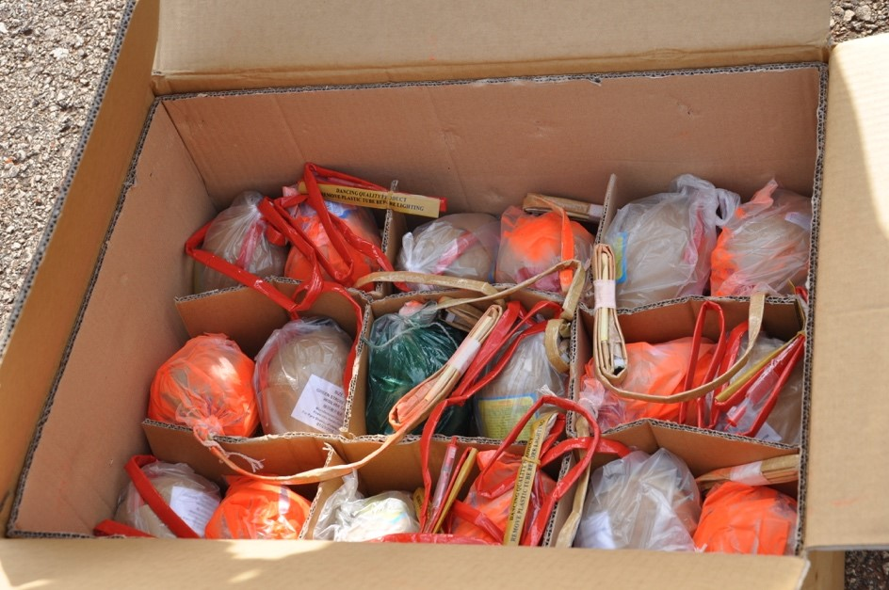
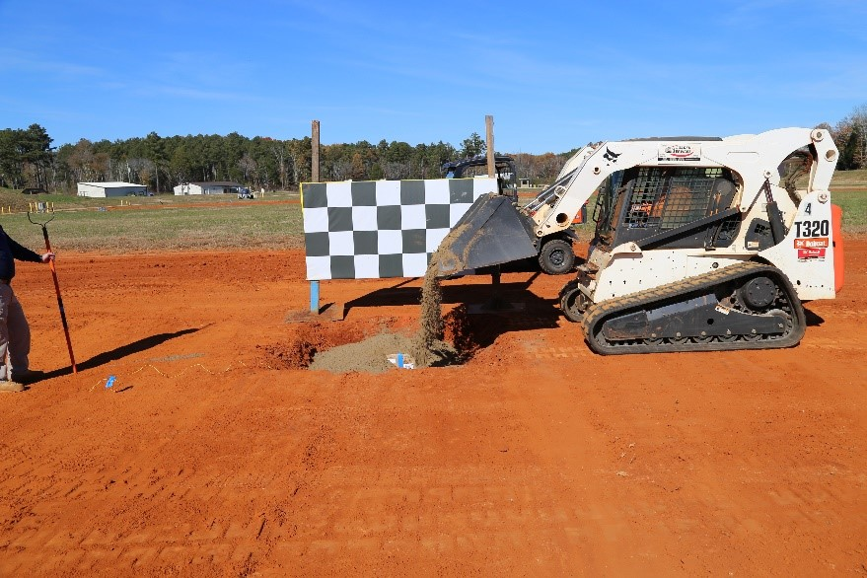
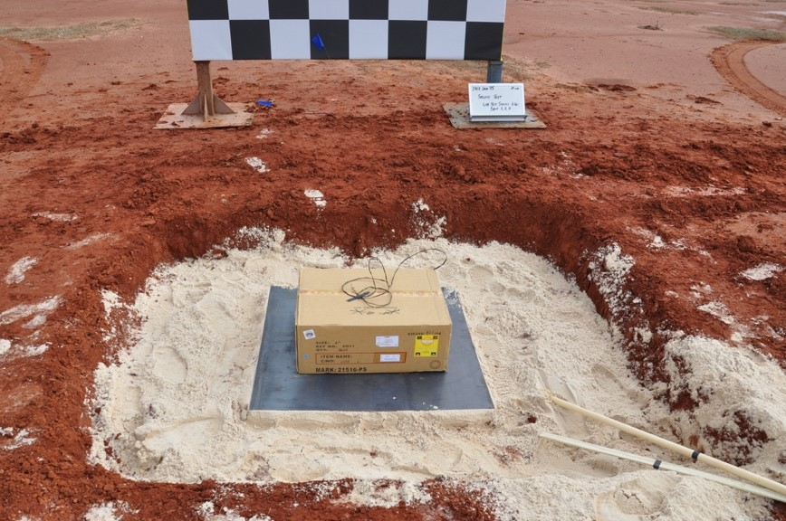
Bulk Salute Testing
50% Salute Shells and 50% Color Shells

Slide 13

Bulk Salute Testing

Slide 14
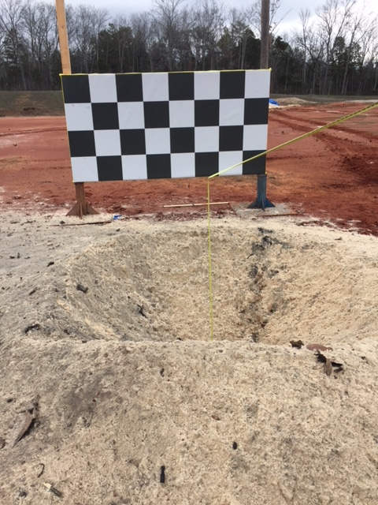
Bulk Salute Testing

Slide 15
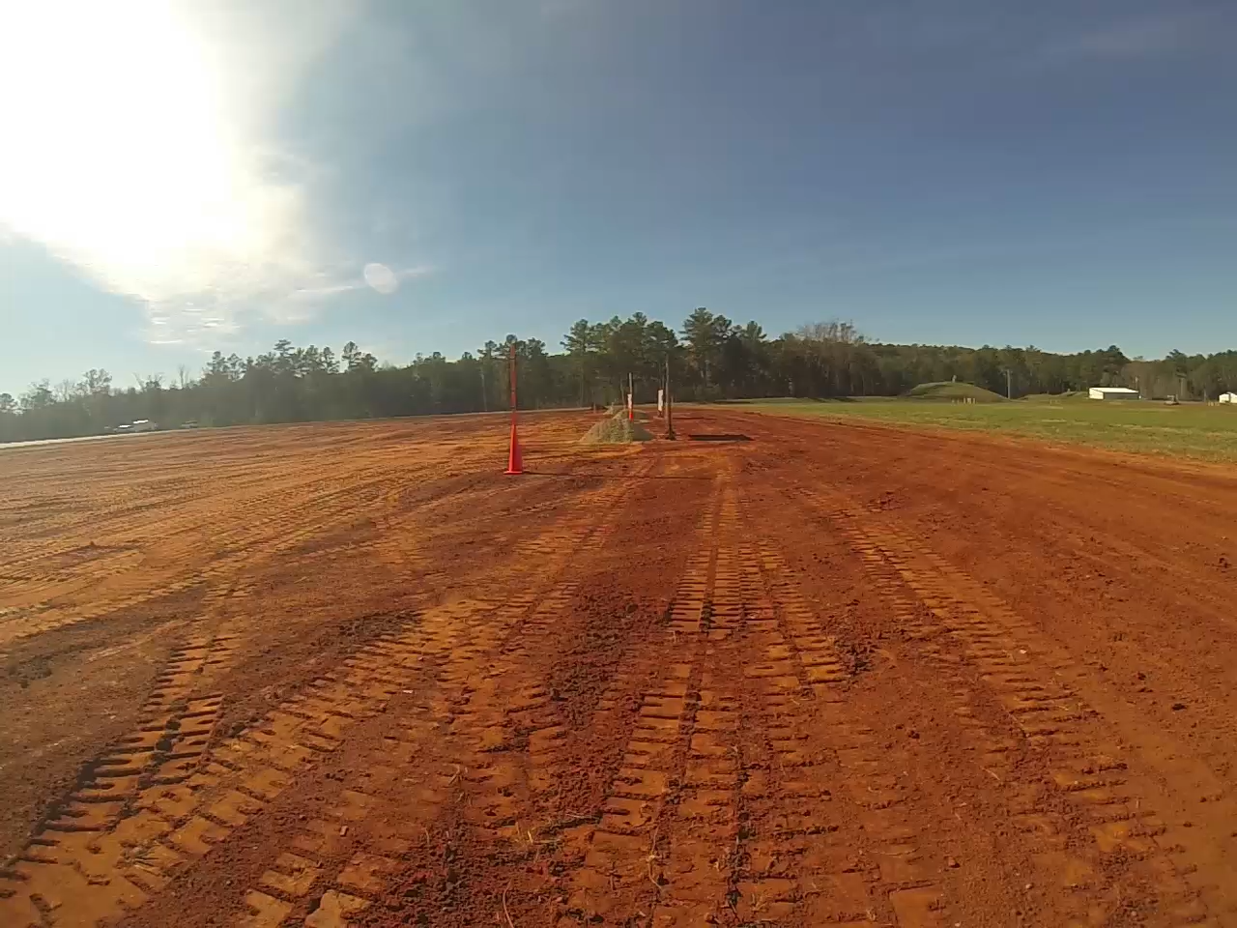
Bulk Salute Testing
75% Salute Shells
25% Color Shells

Slide 16
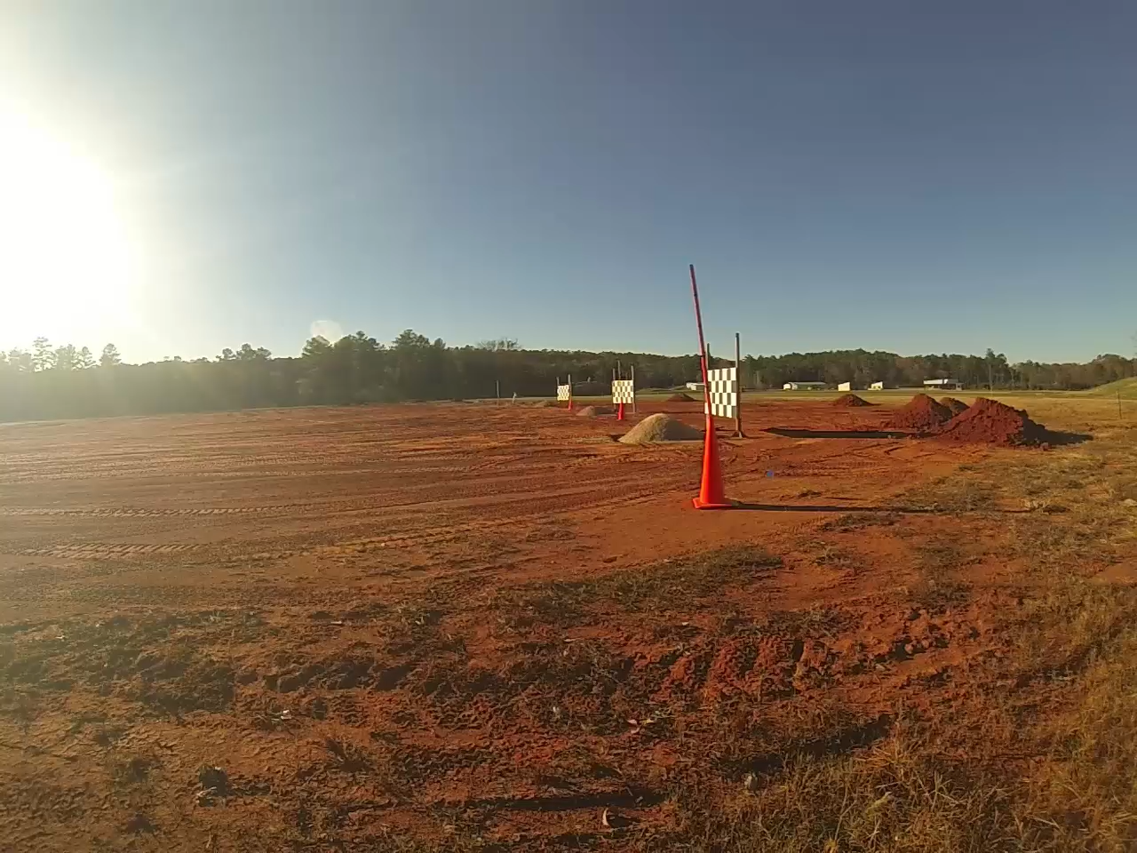
Bulk Salute Testing
71 Salute Shells
1 Color Shell

Slide 17
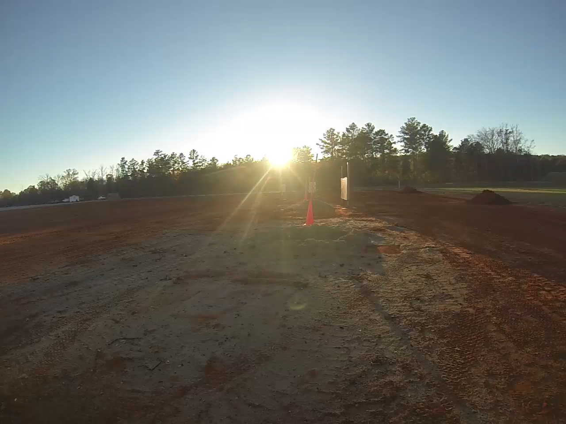
Bulk Salute Testing
100% Salute Shells

Slide 18
Resources and Contact Information
ATF Website: www.atf.gov
Newsletters, Rulings, Open Letters, Pamphlets, etc.
Local ATF Field Offices
“Who We Are”/ “Local ATF Offices”
Explosives Industry Programs Branch (EIPB)
EIPB E-mail Address: EIPB@atf.gov
EIPB Phone Number: (202) 648-7120
Federal Explosives Licensing Center (FELC)
FELC E-mail Address: FELC@atf.gov
FELC Phone Number: (877) 283-3352

