Slide 1




Slide 2
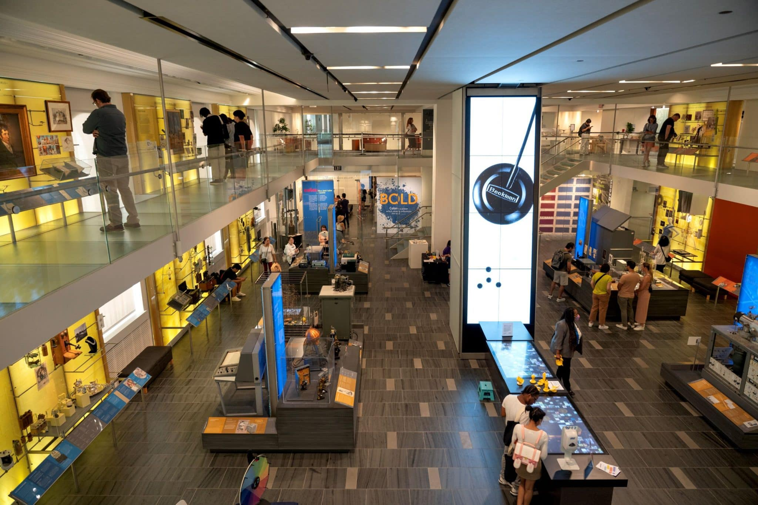

Slide 3
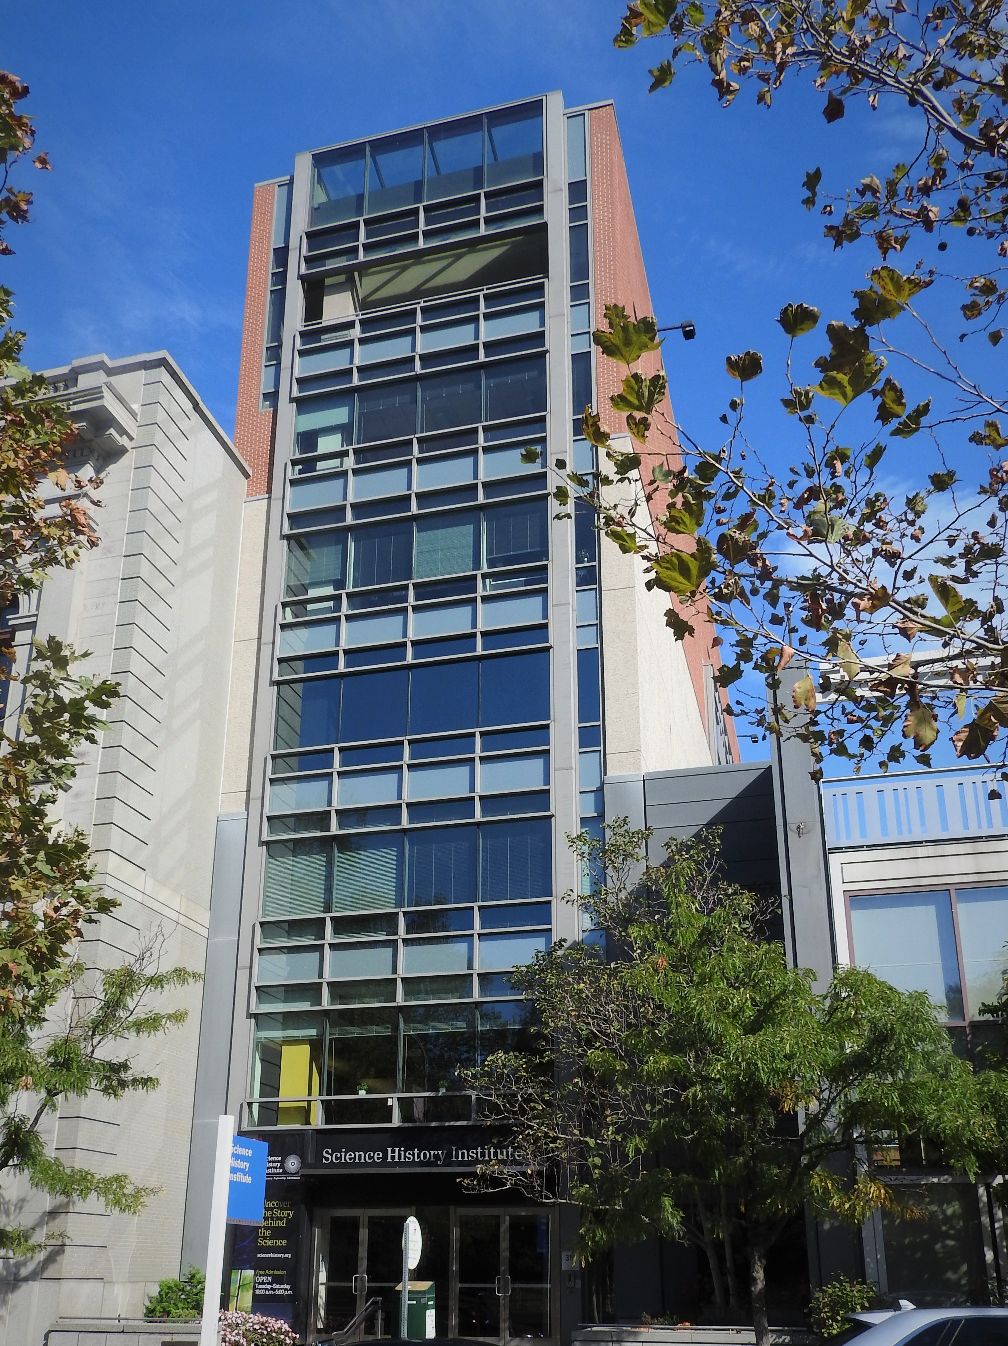
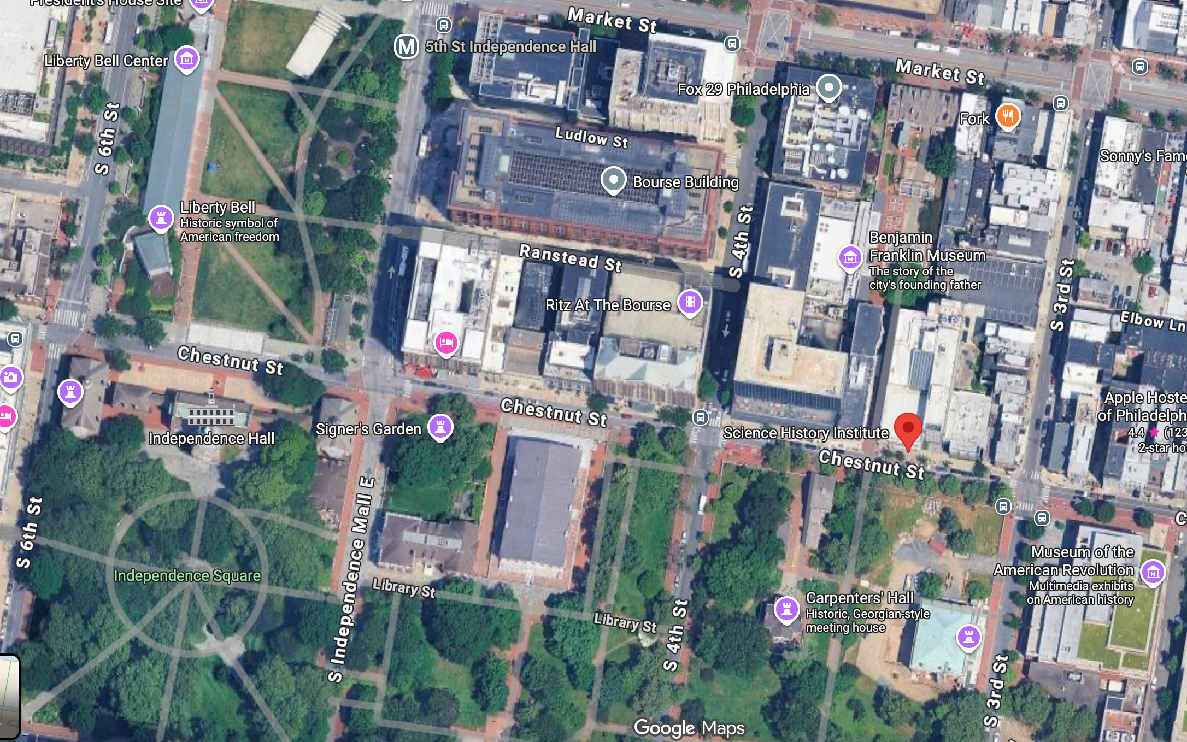

Slide 4

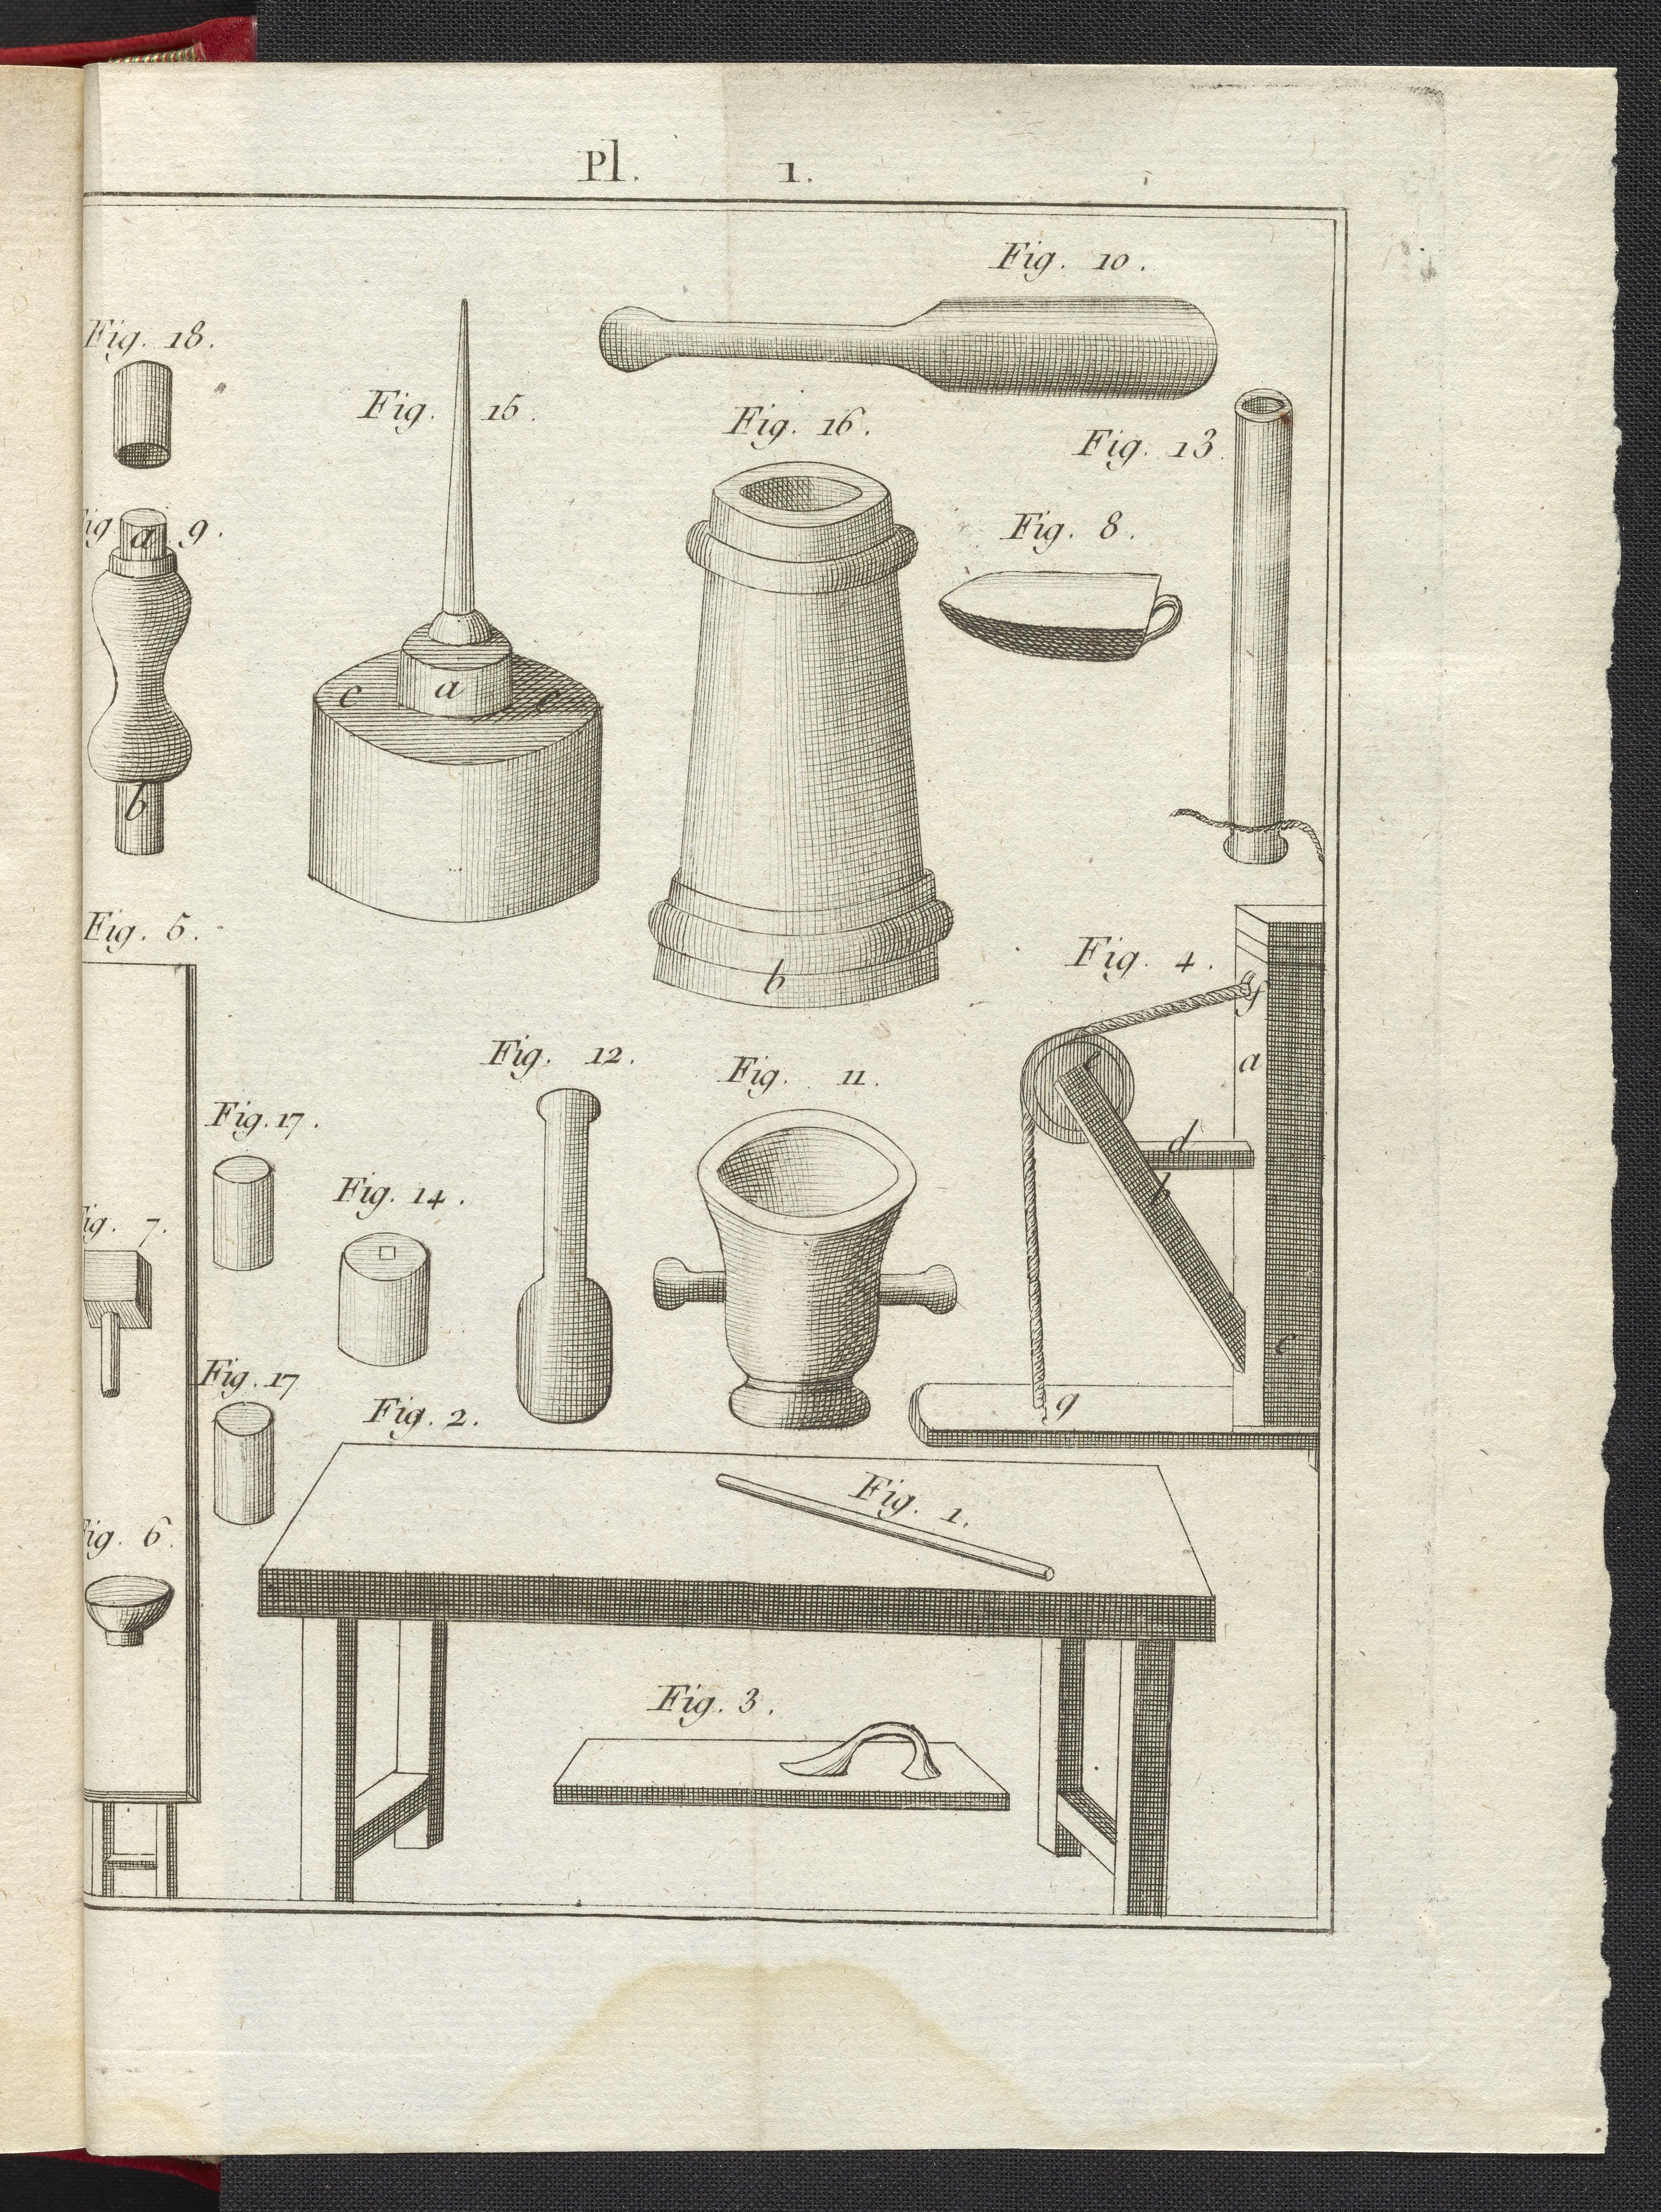
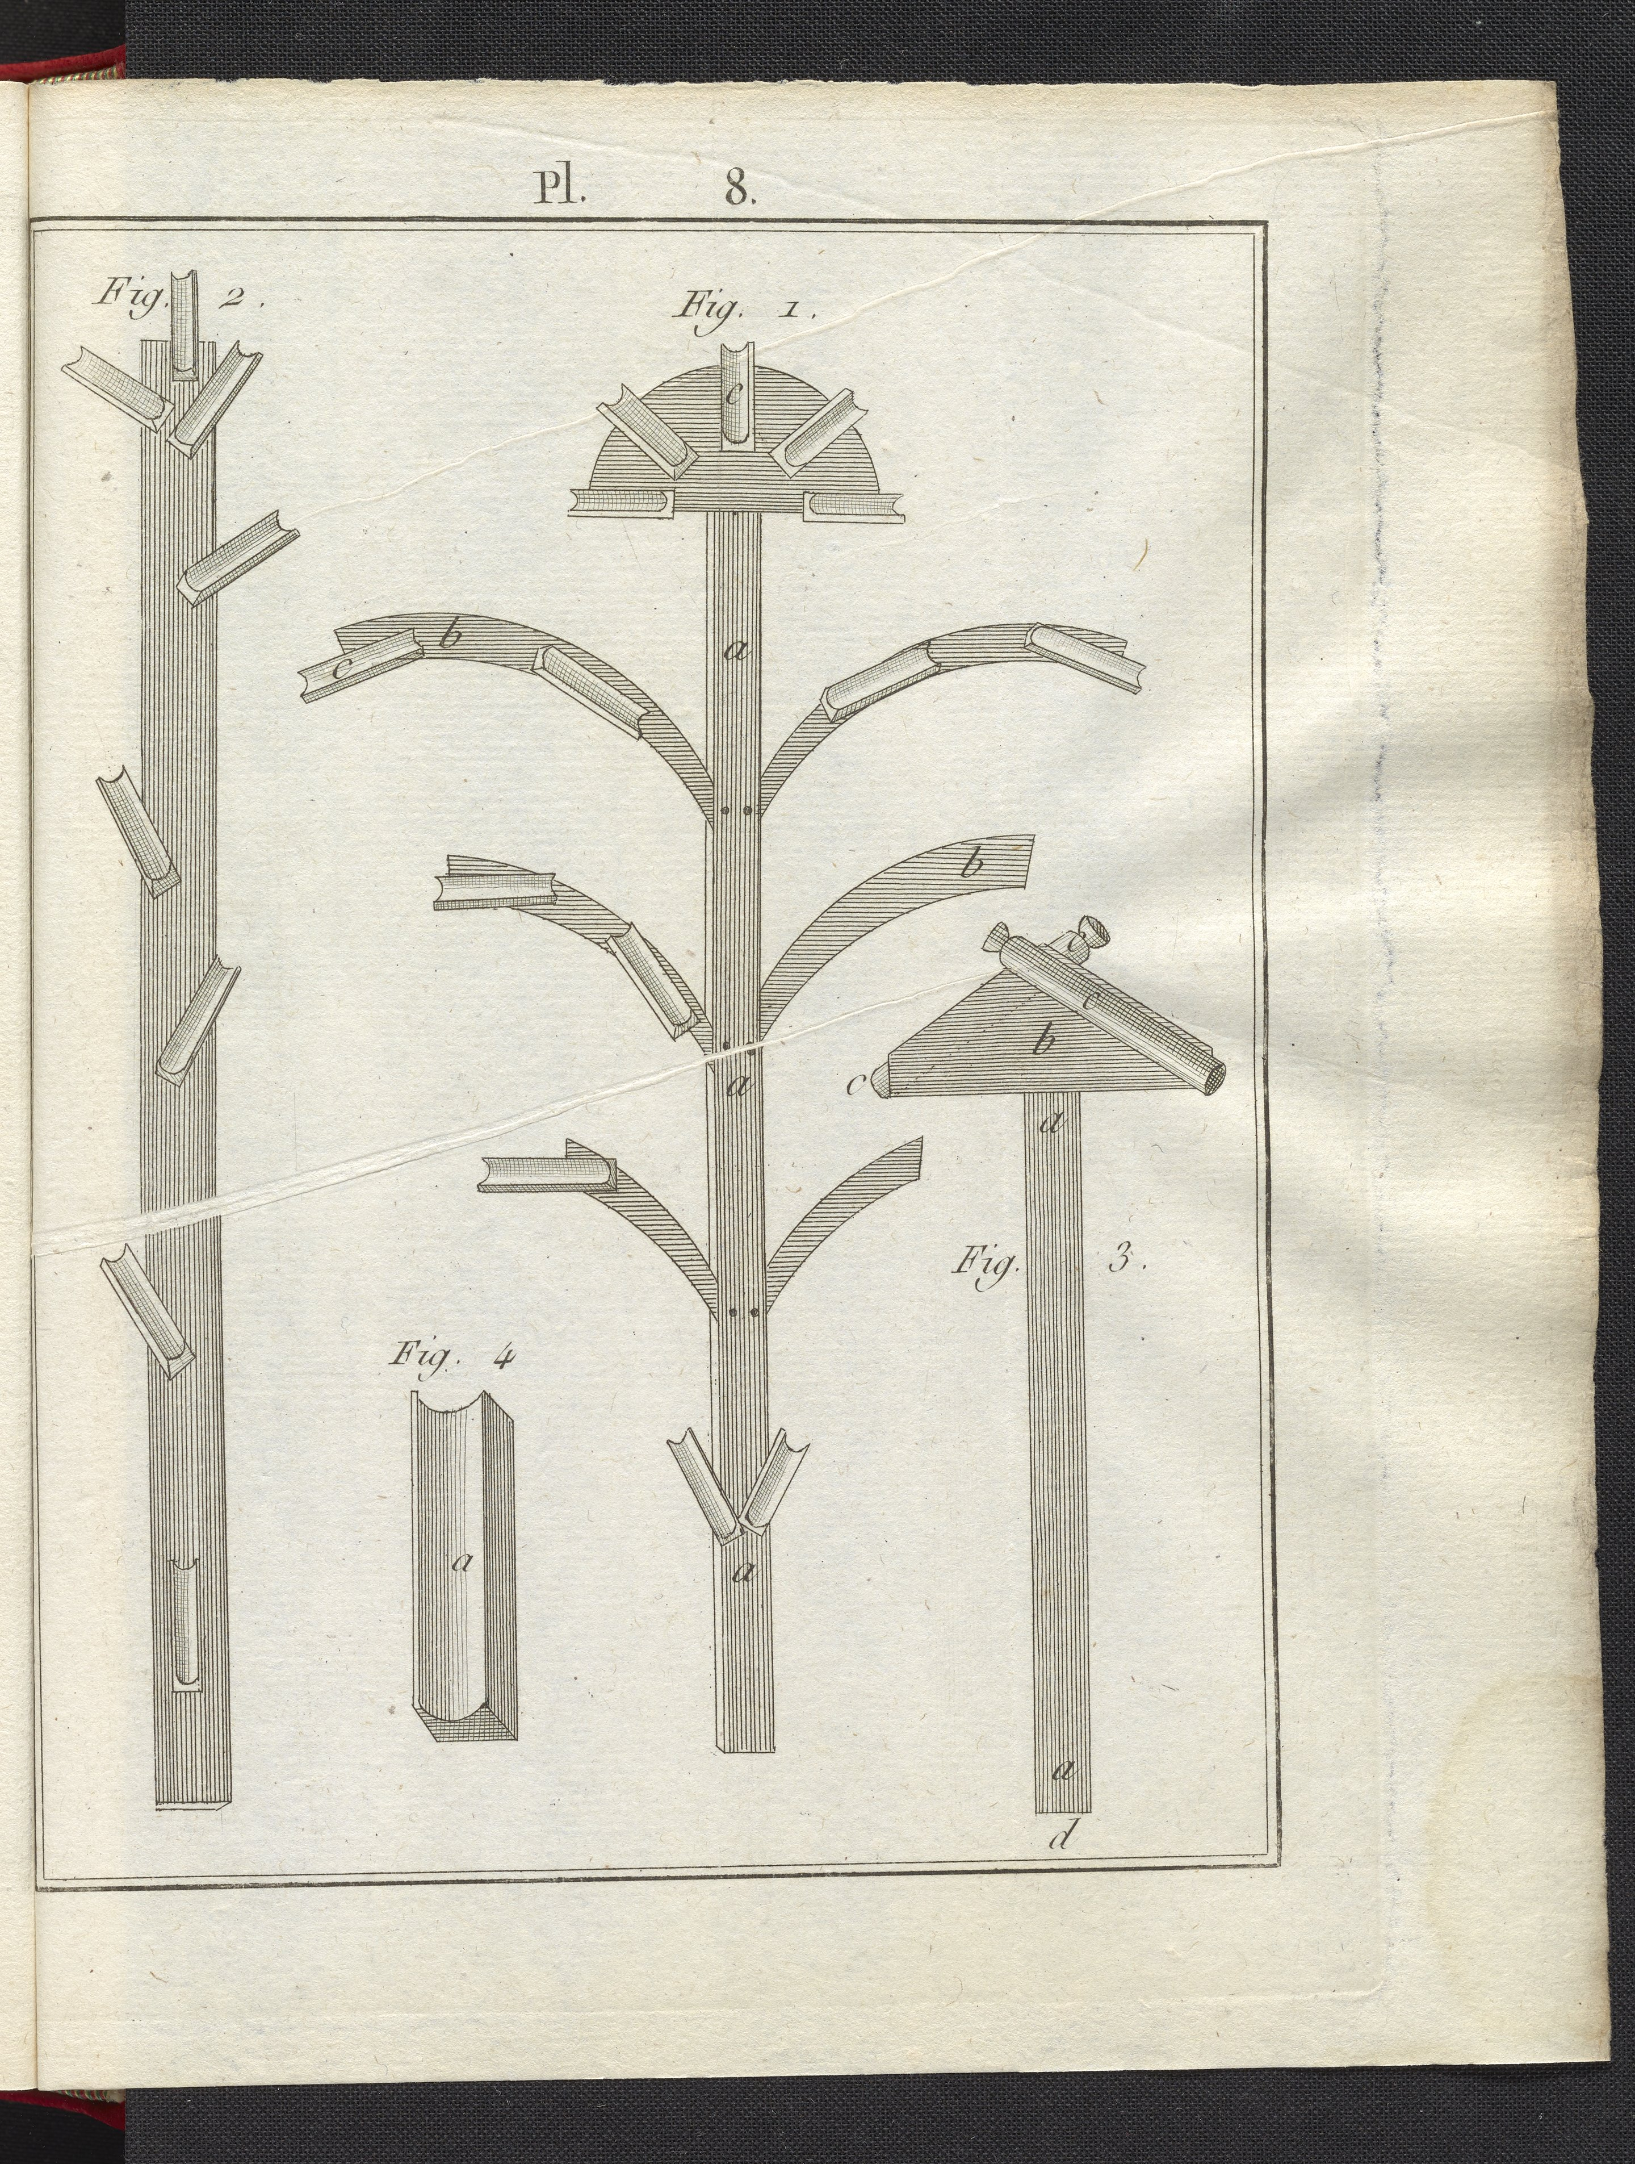

Slide 5
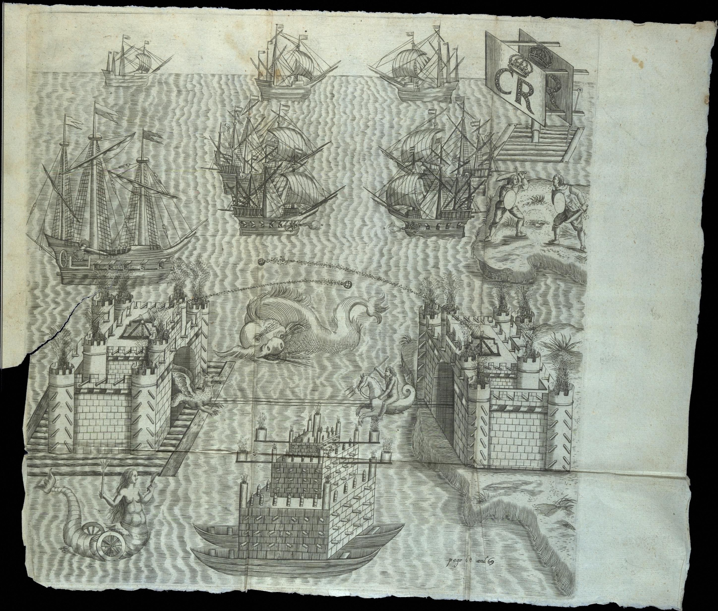

Slide 6
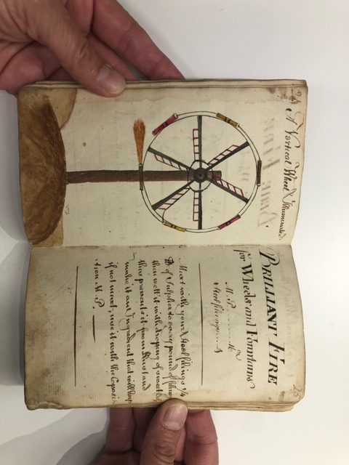
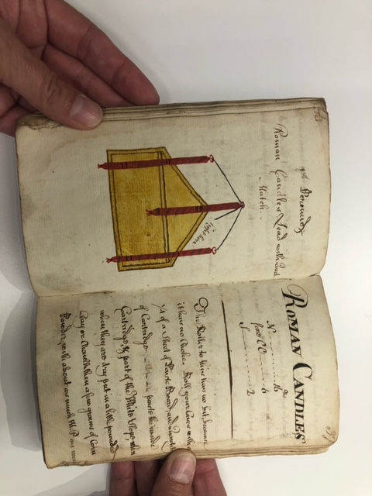
Notes:
TP300 .R43x 1800

Slide 7
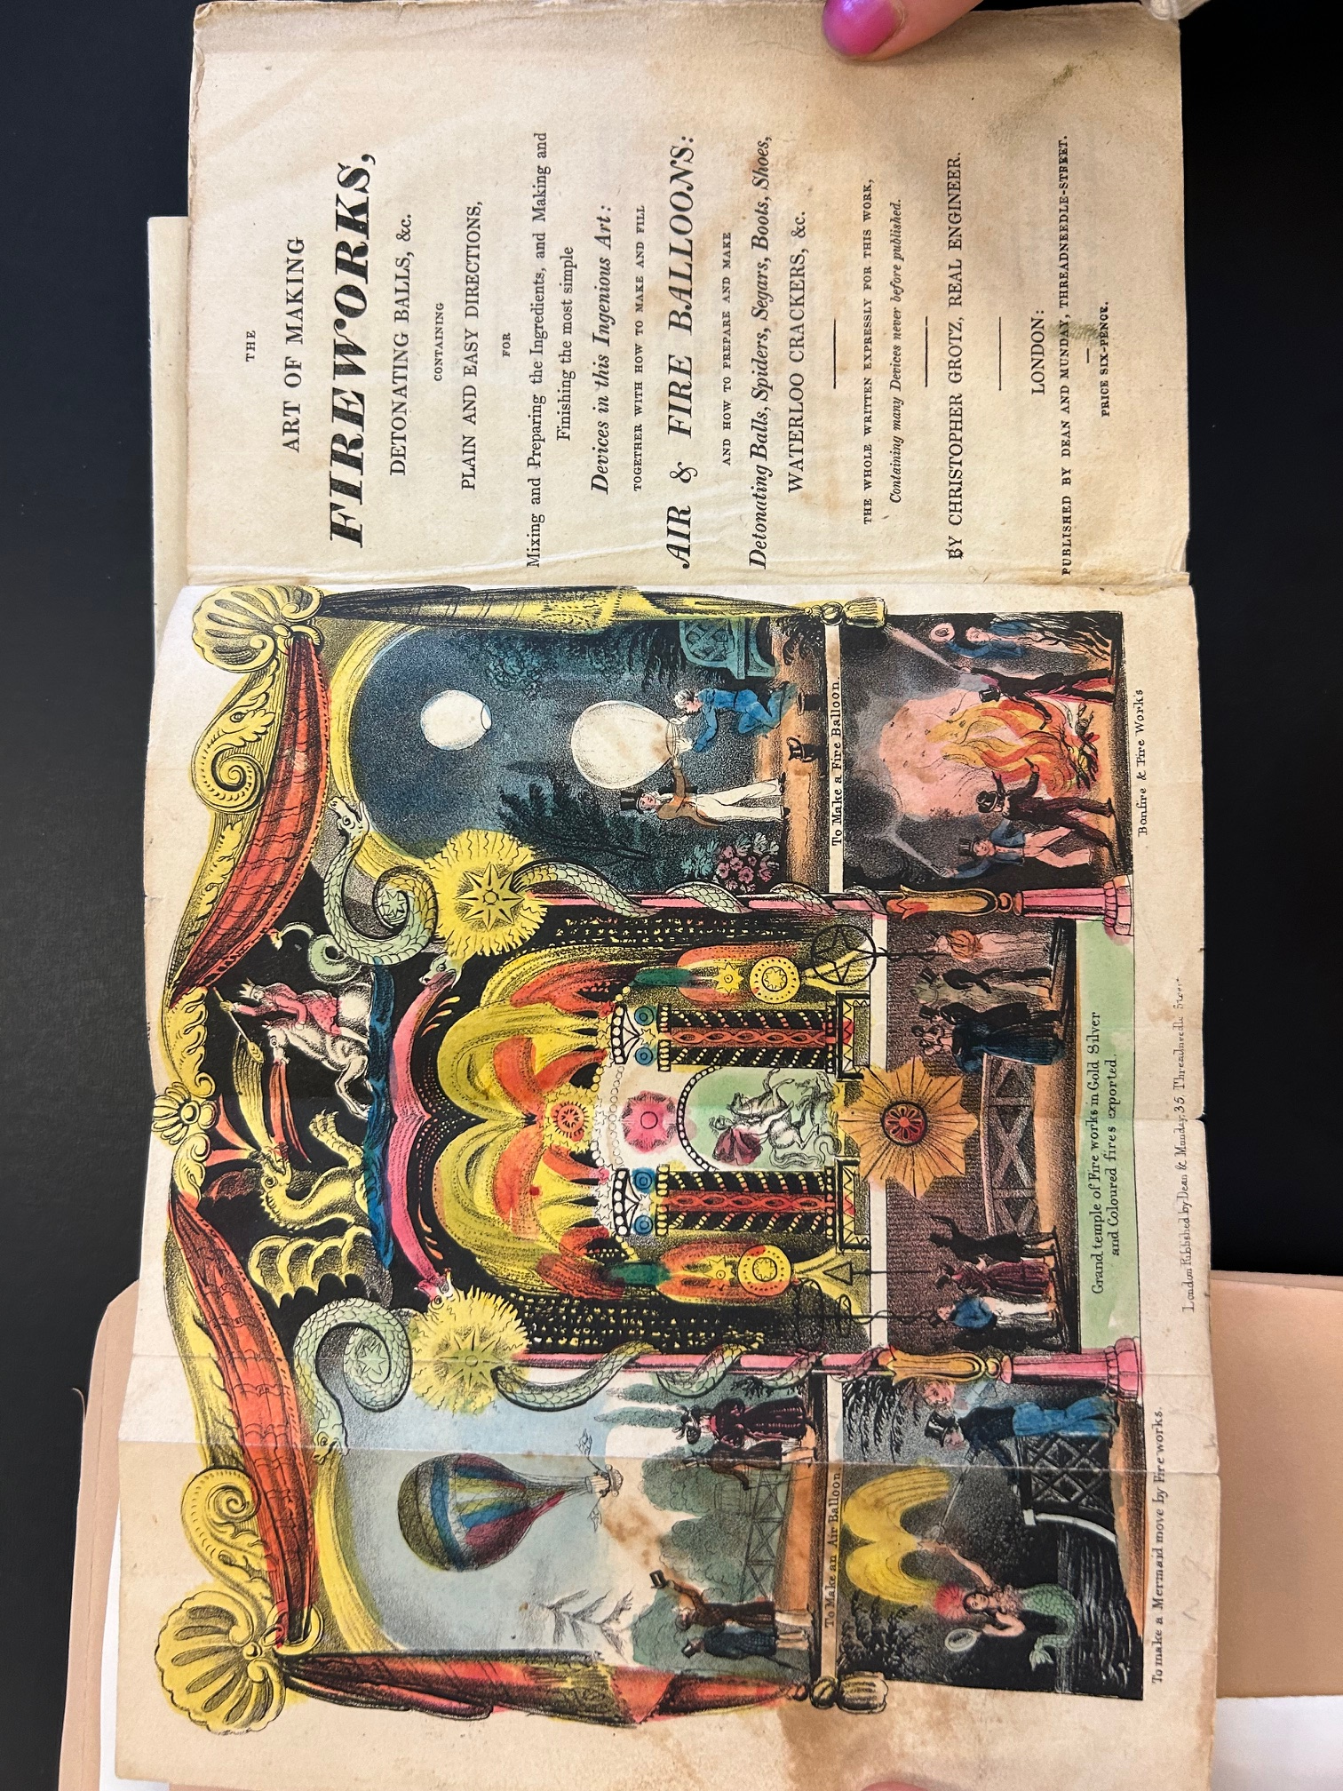

Slide 8
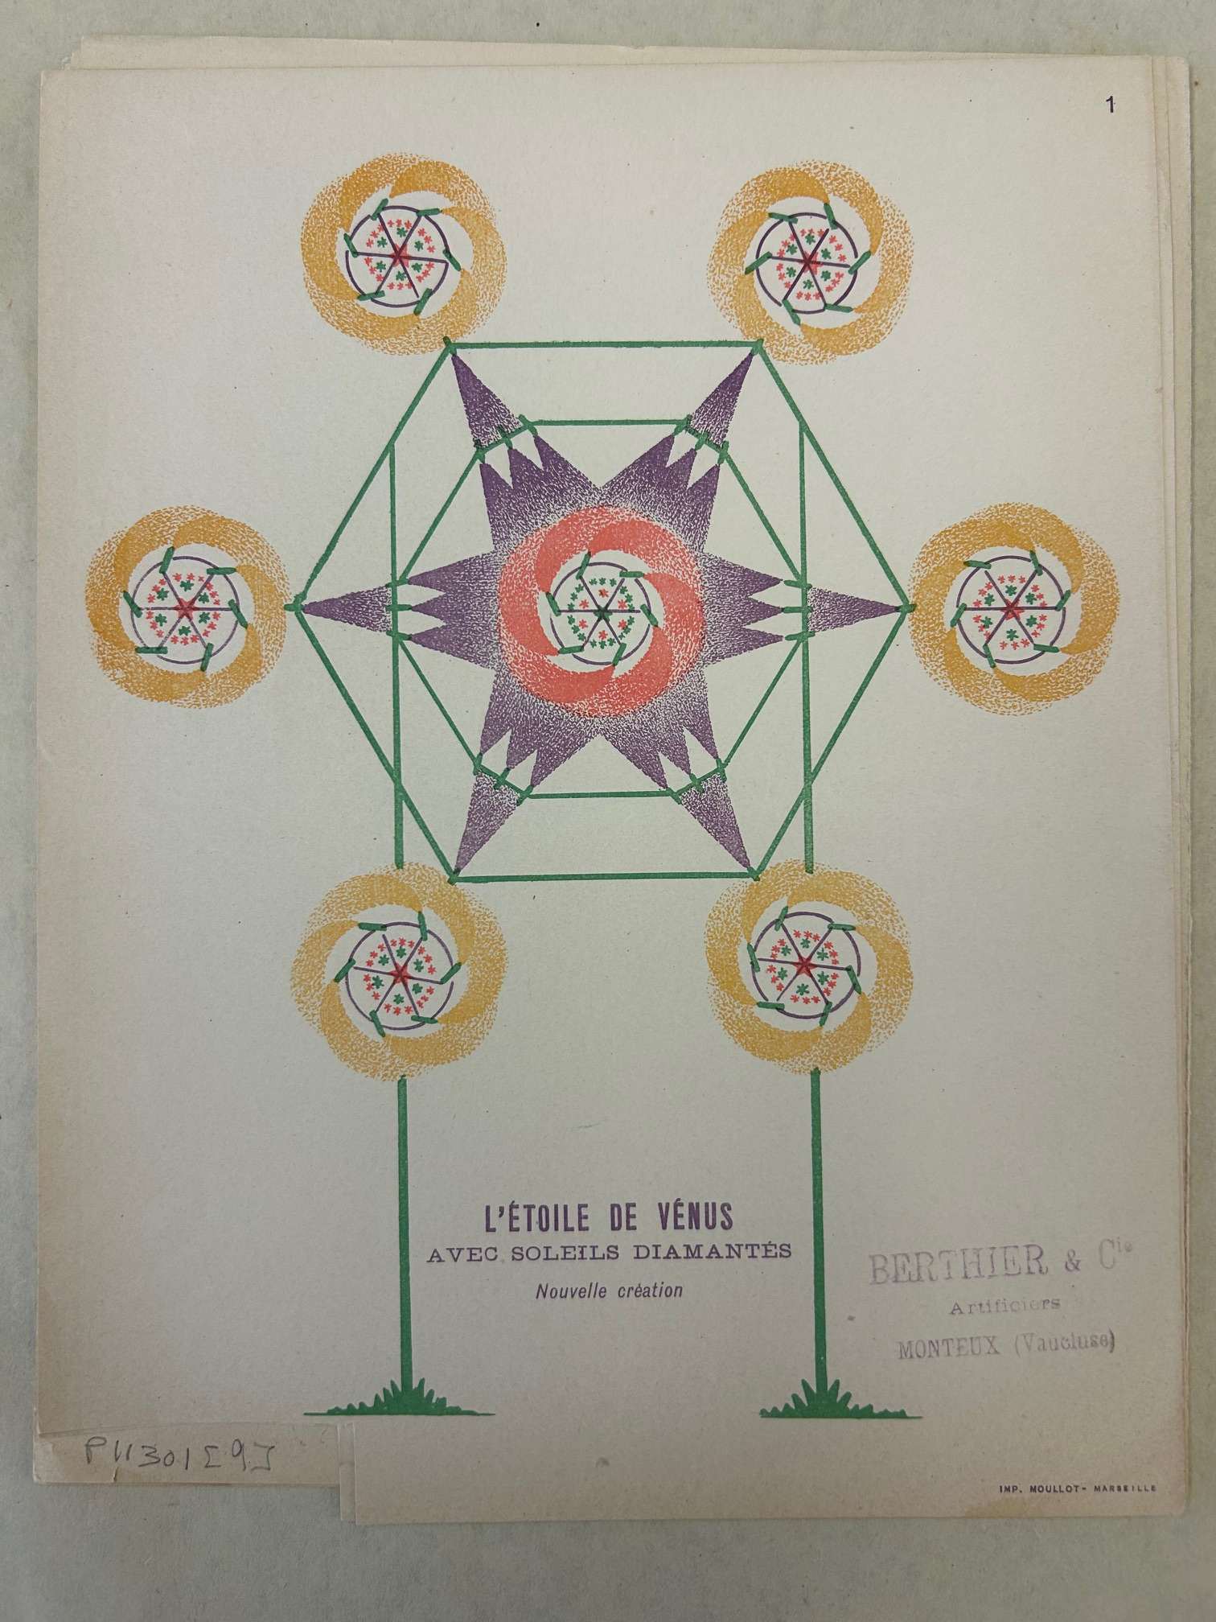

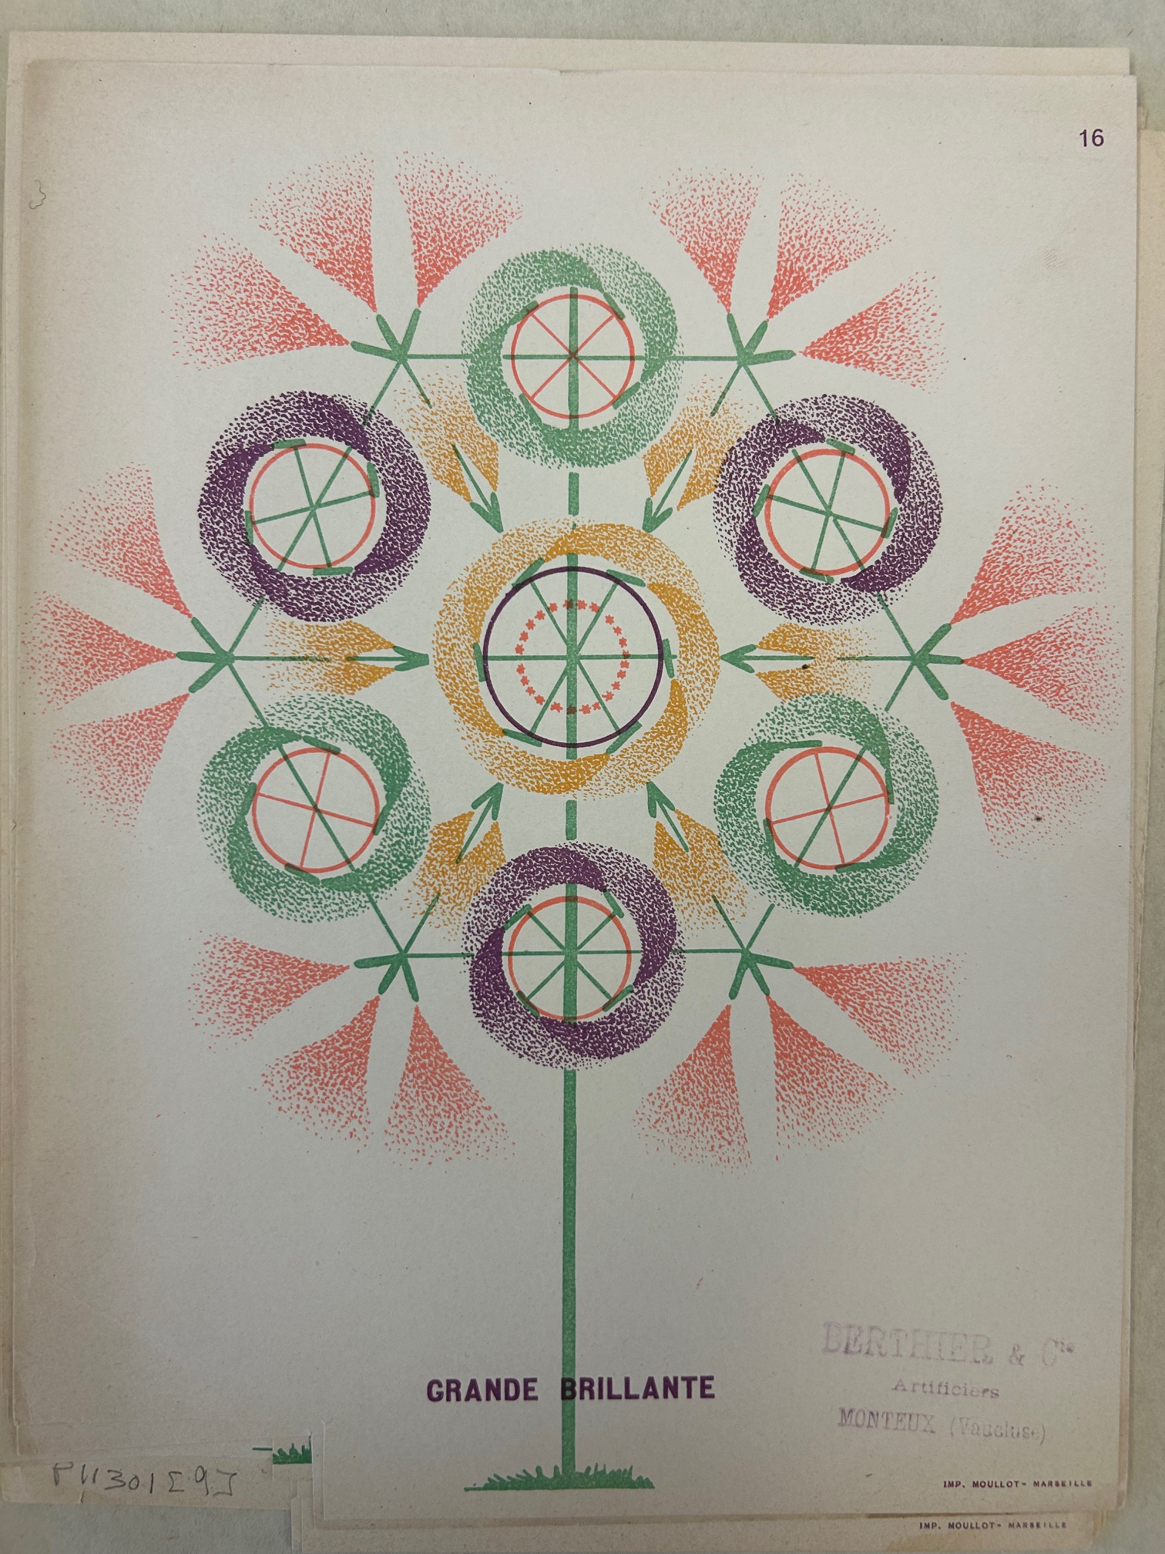

Slide 9

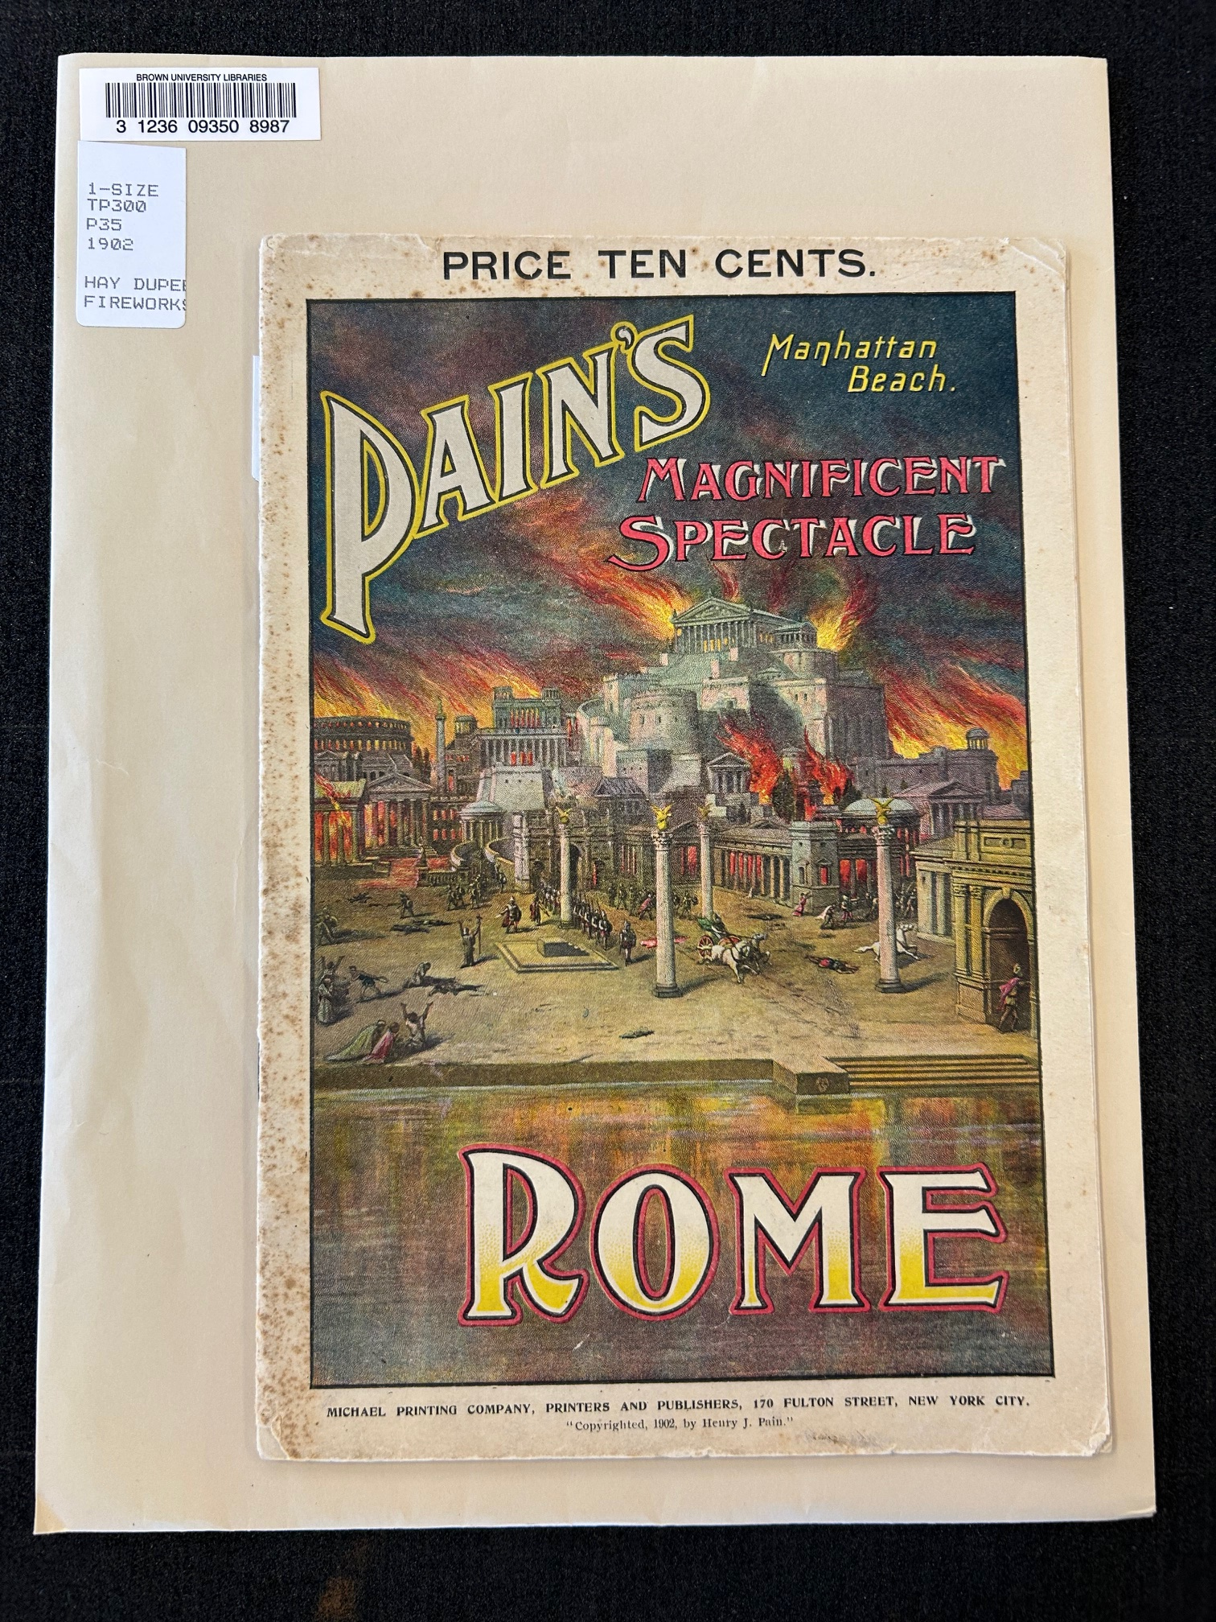

Slide 10
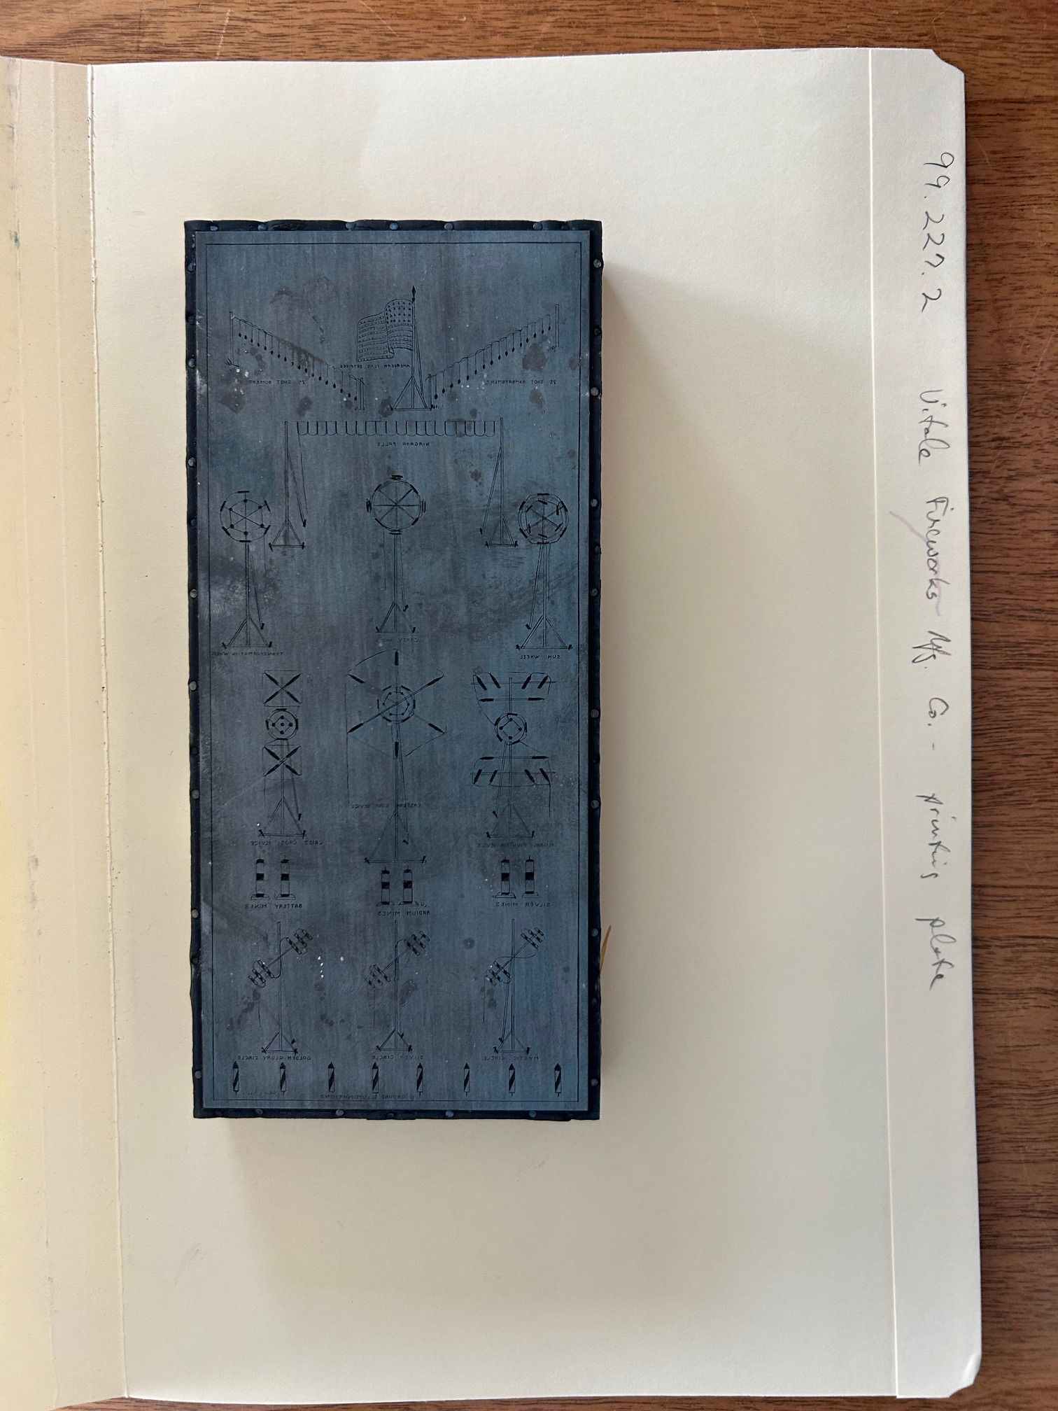
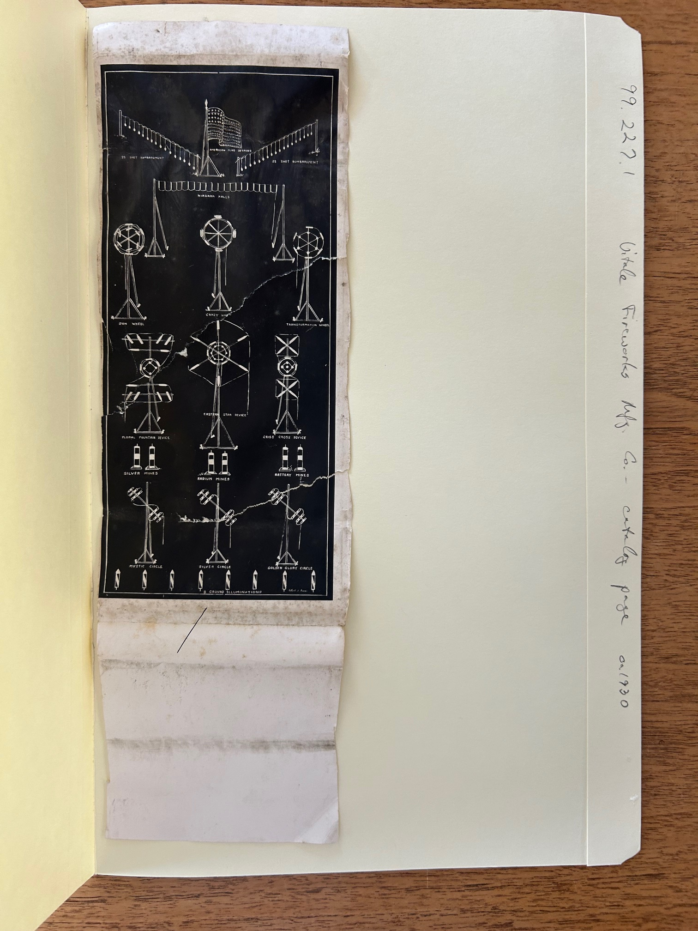

Slide 11
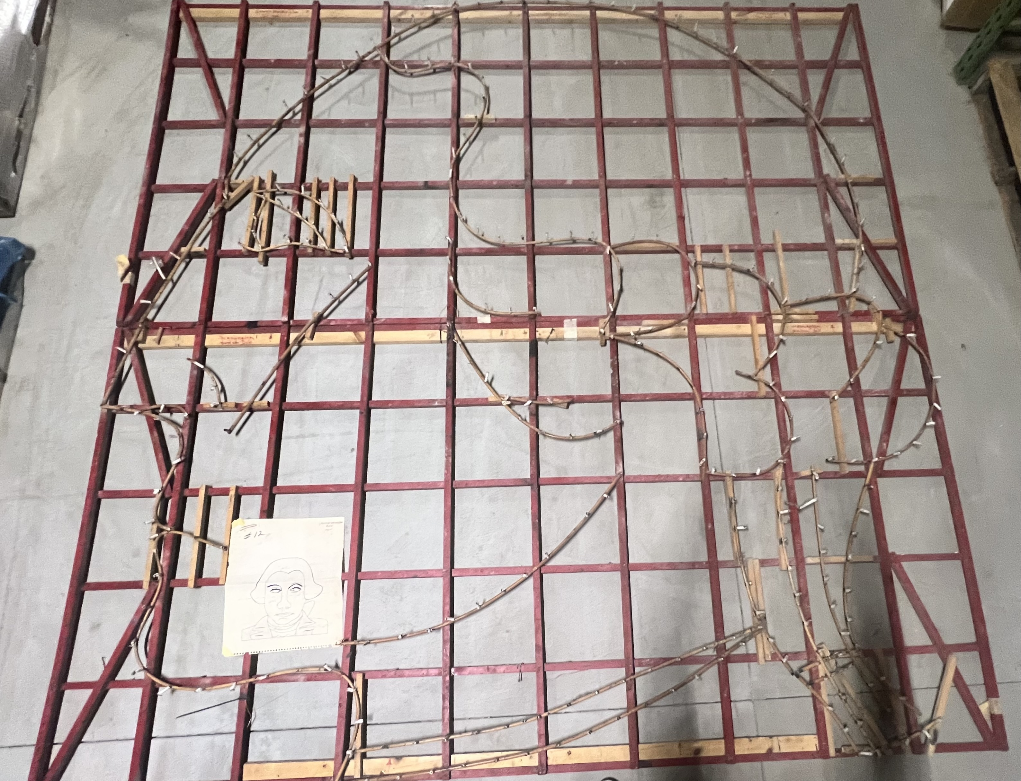

Slide 12
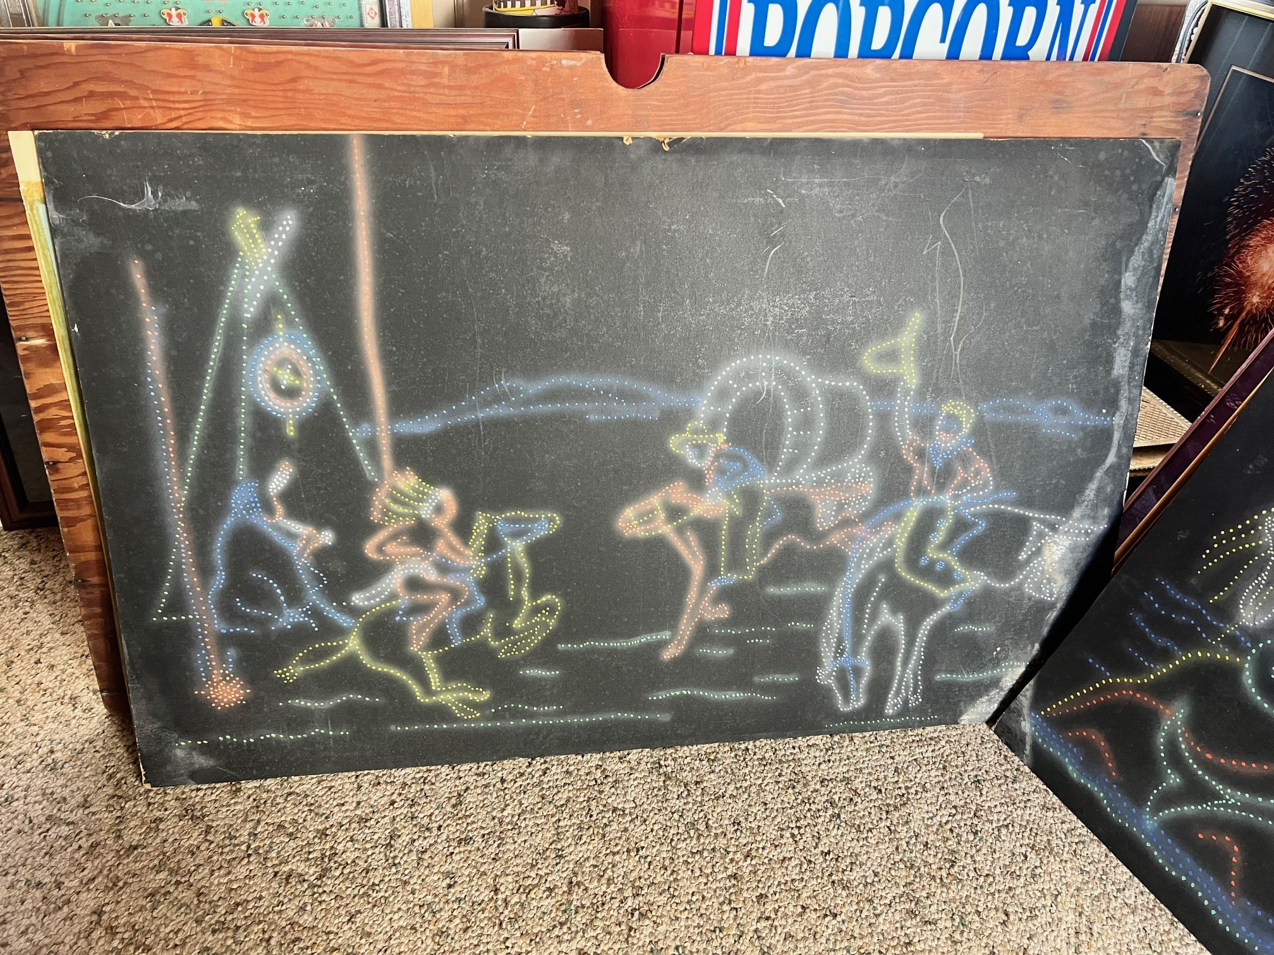

Slide 13
WAYS TO CONTRIBUTE

Slide 14
WAYS TO CONTRIBUTE
1. Historical assets

Slide 15
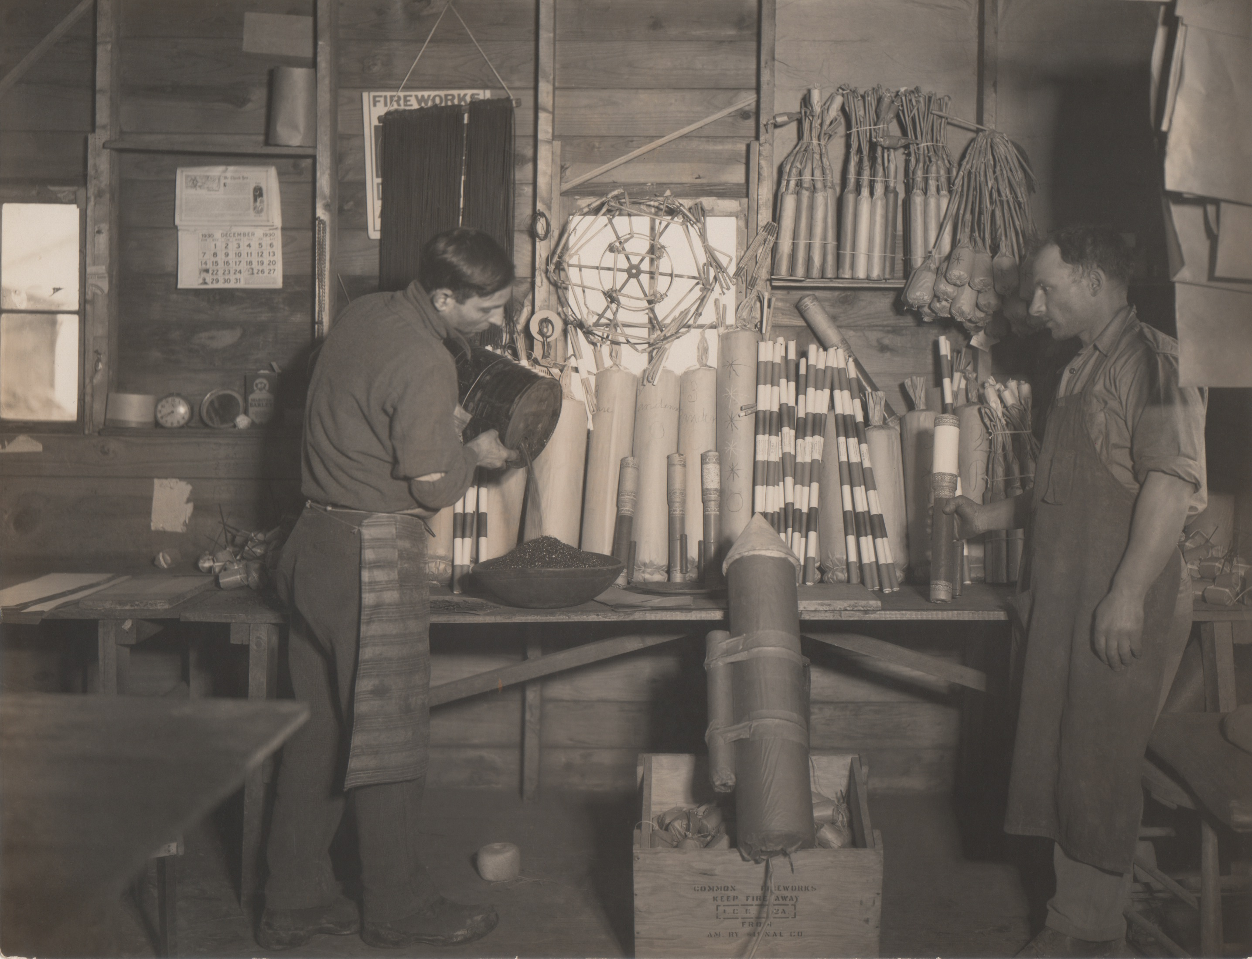
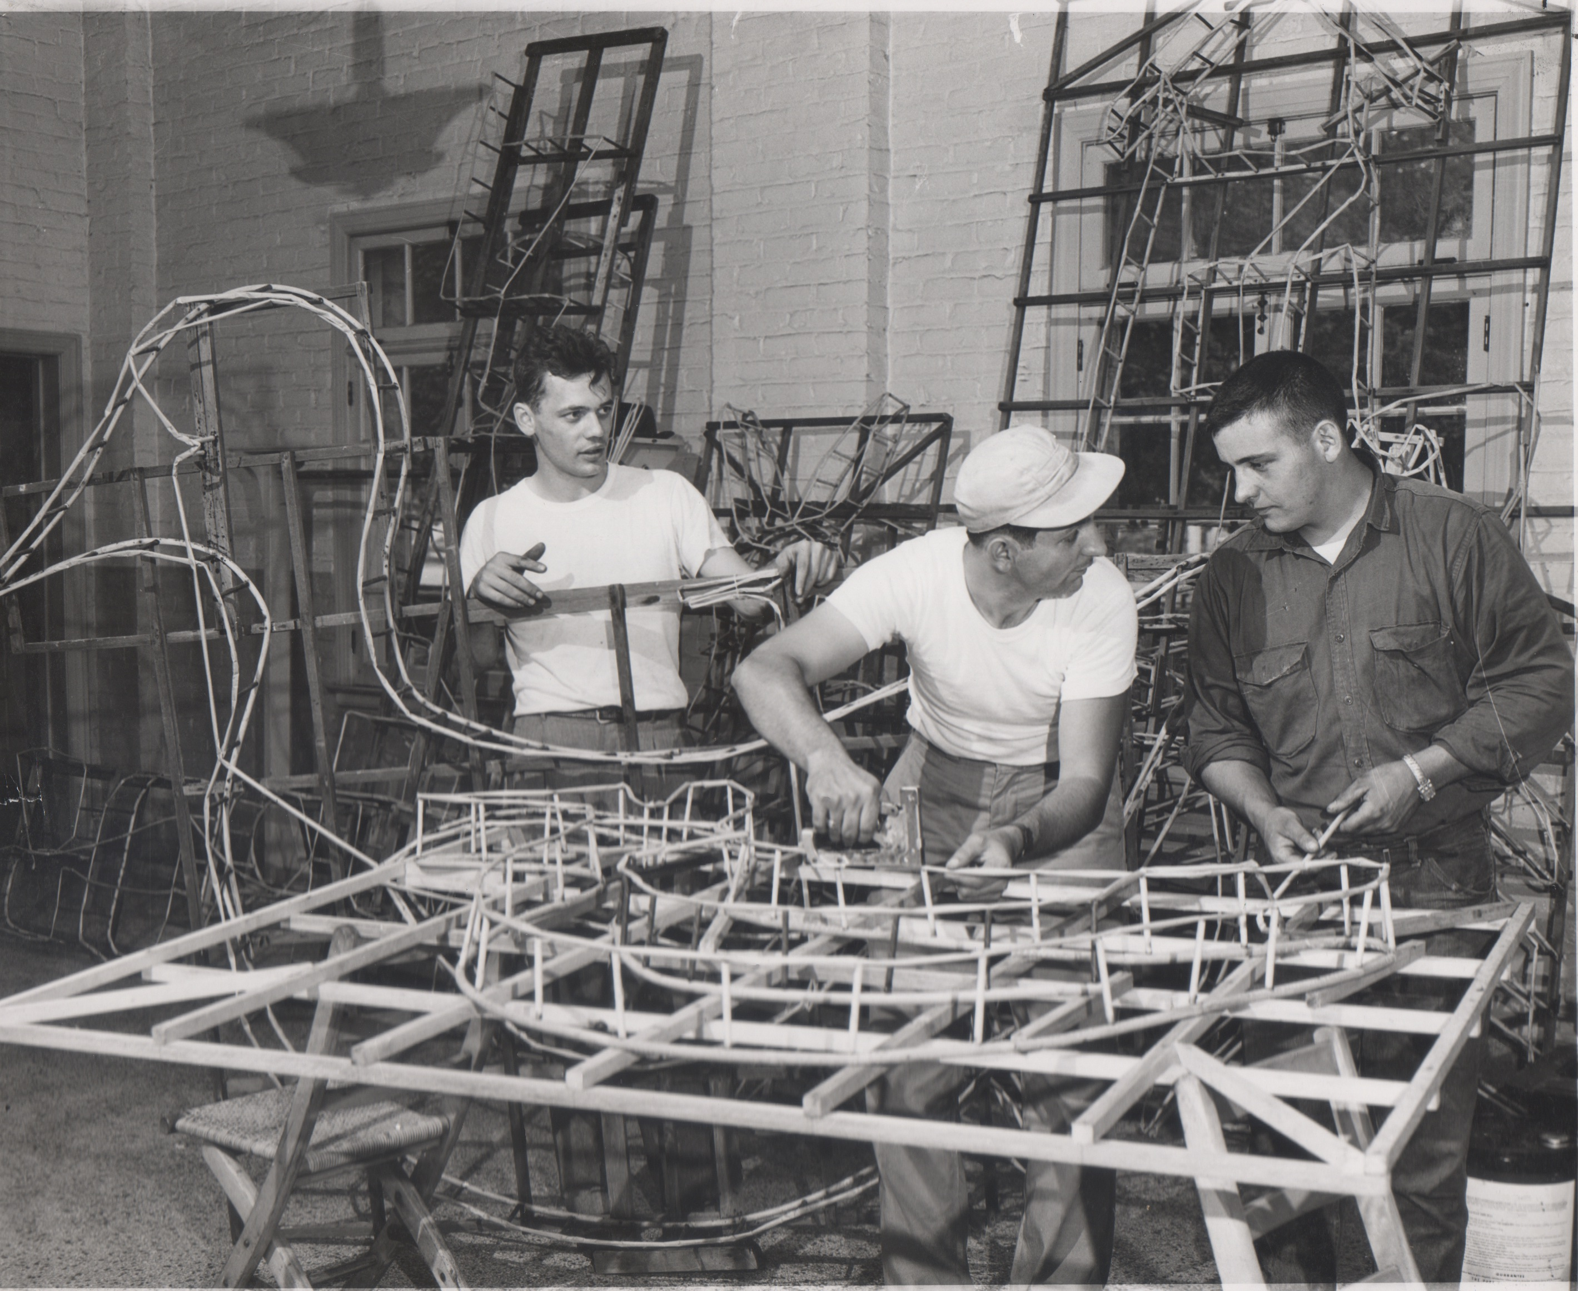

Slide 16
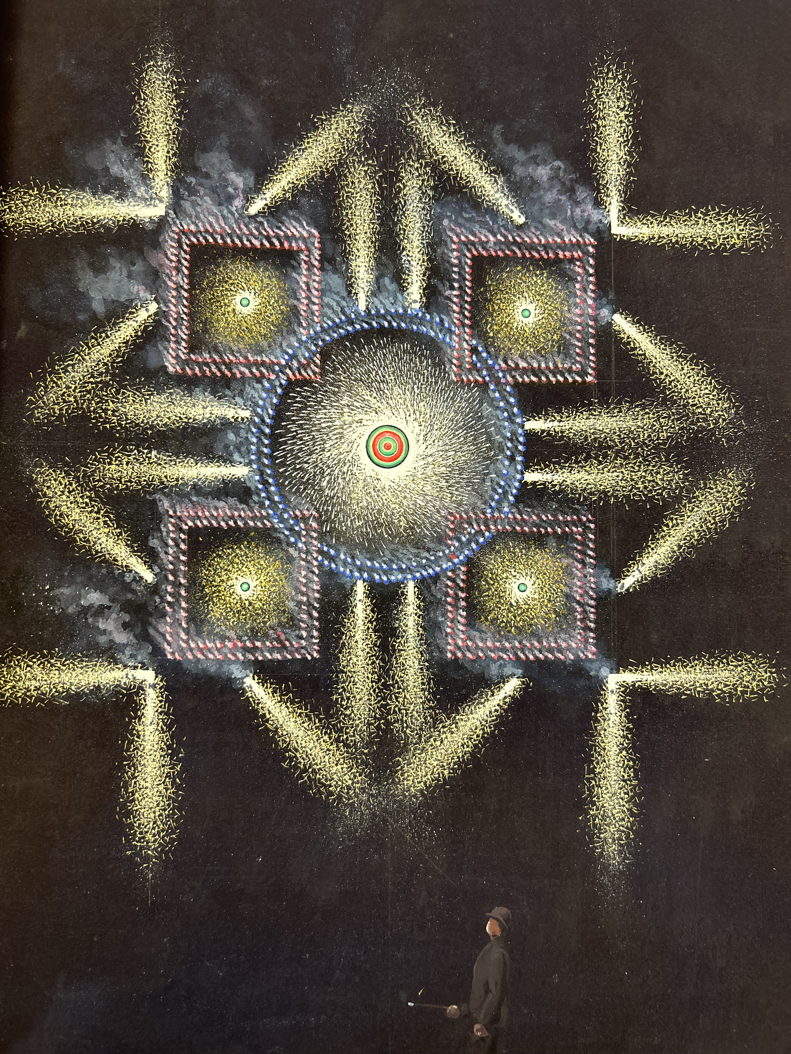

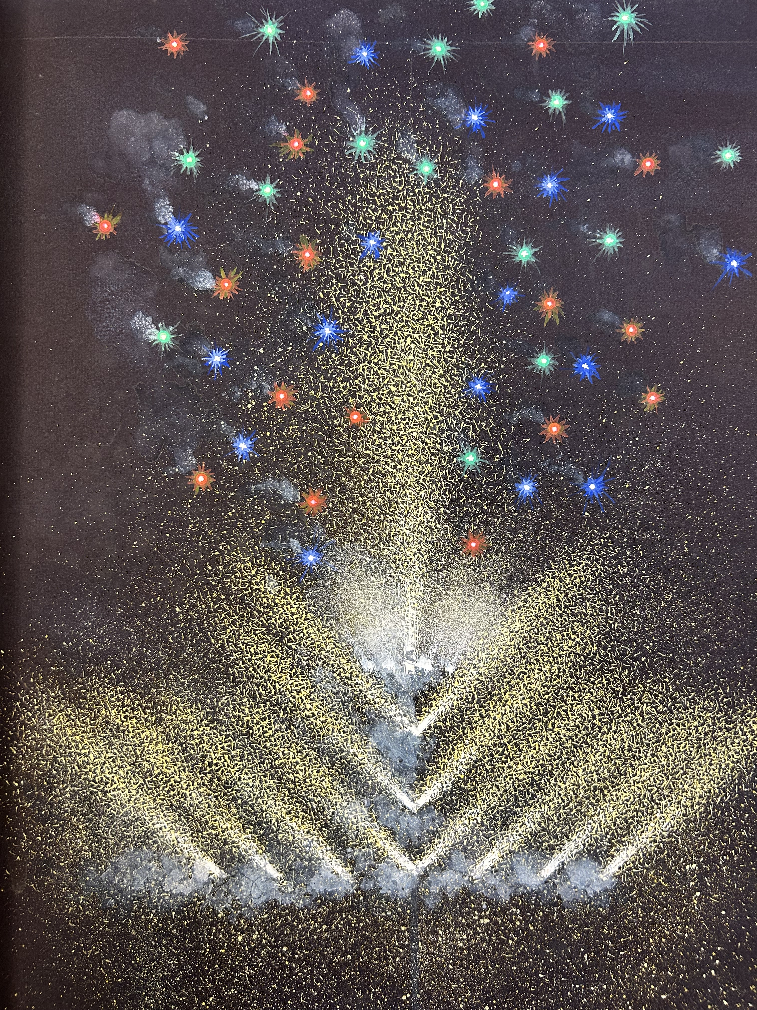

Slide 17
WAYS TO CONTRIBUTE
1. Historical assets
2. Historical content

Slide 18
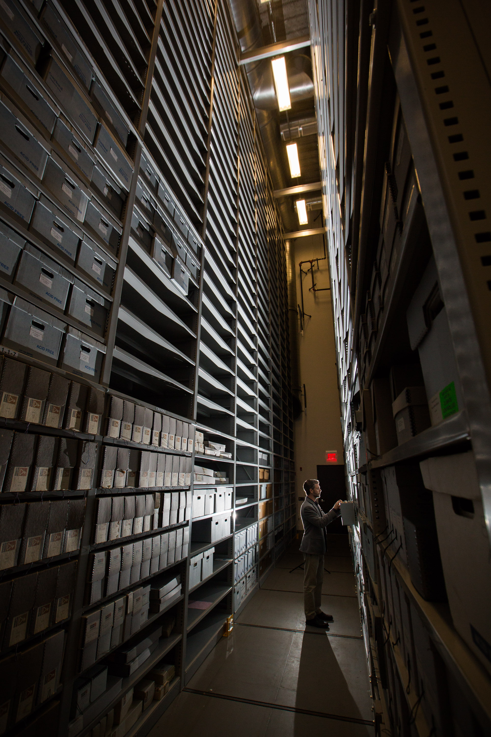
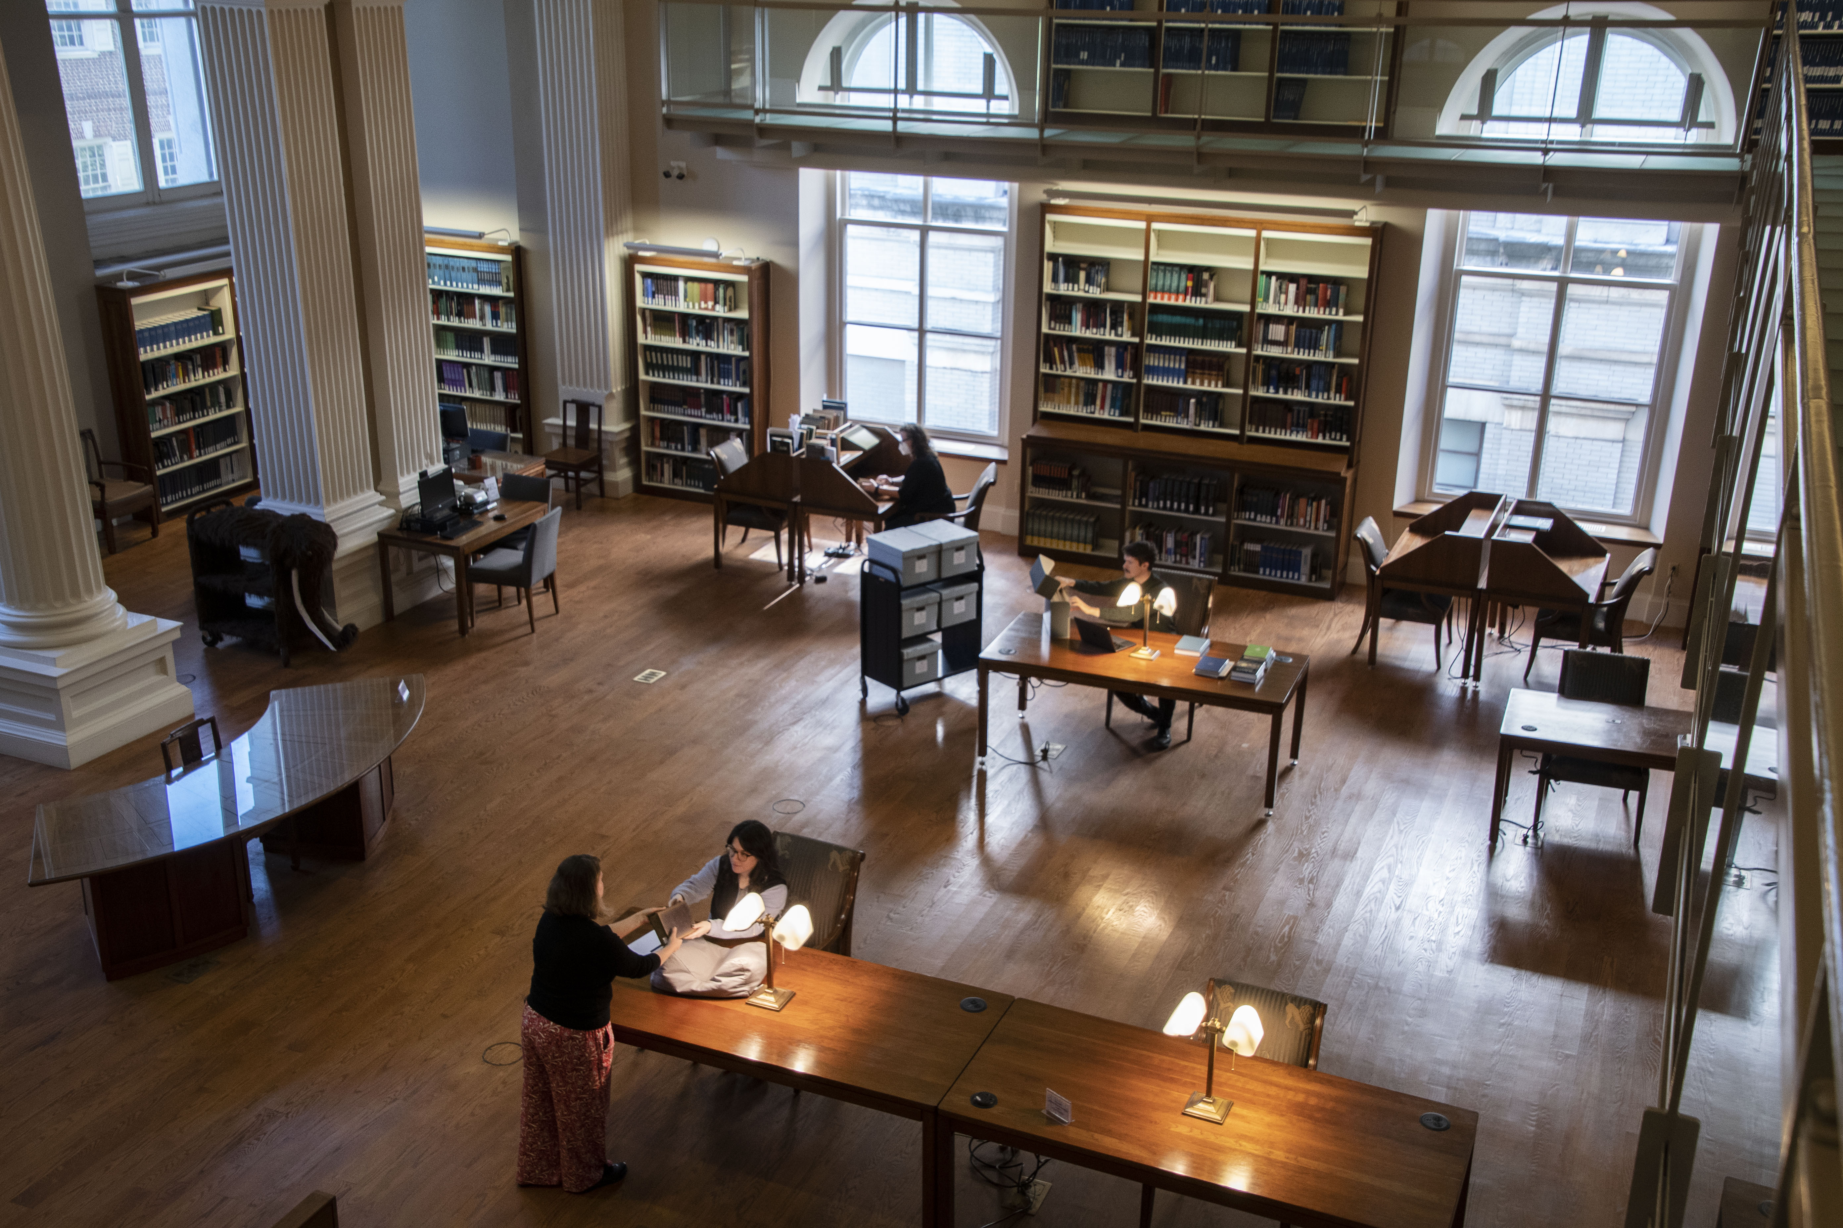

Slide 19
WAYS TO CONTRIBUTE
1. Historical assets
2. Historical content
3. Sponsorship

Slide 20


Slide 21



Slide 22
WAYS TO CONTRIBUTE
1. Historical assets
2. Historical content
3. Sponsorship
4. Spreading the word!

Slide 23



Slide 24
April 2026 — August 2027
jsmith@sciencehistory.org
@scihistoryorg

