Slide 1
5 Star Communication:
Navigating Critical Conversations
February 9, 2022

Slide 2
Get the Most from this Training!
Be Present, Remove distractions, Put your phone away
Have your printed handouts in front of you
Fully participate:
Share your thoughts
Be curious – ask questions
Be honest and vulnerable
Release judgment of yourself and others
Have water and your favorite snacks with you!

Slide 3
Mindful Moment:
Come into the Present
Moment
Simply focus on your breath…
3

Slide 4
What is a Critical Conversation?
Group Discussion

Slide 5
5 Star Communication Style Assessment Debrief
What is your most natural style?

Slide 6
Poll Question: Choose the communication style most like you:
Direct
Passionate
Collaborative
Careful
5 Star
6

Slide 7
Communication is easy – texting, emails, directives. Dialogue is where human beings come together and connect with their minds and hearts. They share with each other, think together and debate respectfully. They observe, seek to understand and learn together. It is a journey of trust, vulnerability & respect. Marguerite Ham

Slide 8
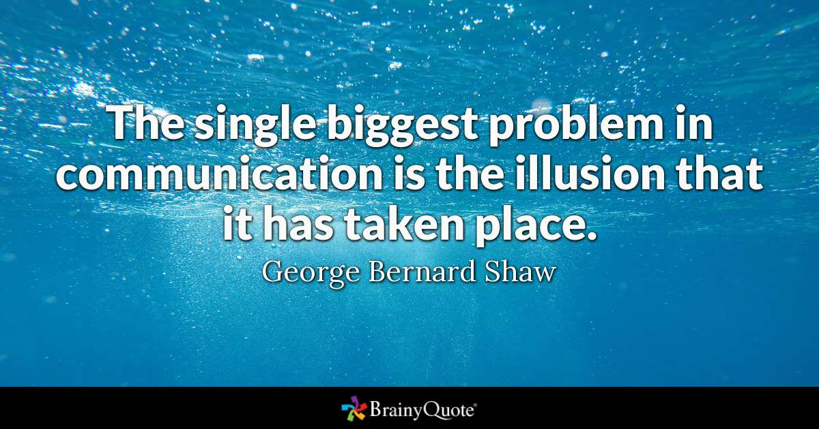
8

Slide 9
Communication Styles

Slide 10
External
Fast
Assertive
Communication Styles
Direct
Assertive
Strong
Impatient
Results Focused
Passionate
Talkative
Outgoing
Optimistic
Future Focused
Careful
Restrained
Questioning
Cautious
Data Focused
Collaborative
Calm
Sincere
Accepting
People Focused
My Primary/Natural Style Is:
Gifts & Gaps of this Style
Task
Negative
Challenging
People
Positive
Accepting
Group Discussion: Gifts & Gaps of each style.
Internal
Slow
Reserved

Slide 11
External
Fast
Assertive
Direct
Assertive
Demanding
Judgmental
Results Focused
Passionate
Talkative
Outgoing
Optimistic
Future Focused
Careful
Restrained
Questioning
Cautious
Data Focused
Collaborative
Calm
Sincere
Accepting
People Focused
Be a 5 Star Communicator
Task
Negative
Challenging
People Accepting
Positive
Ac
Group Discussion: How can I develop the skill of morphing in and out of each style and meeting others in their communication style?
Internal
Slow
Reserved
11

Slide 12
Listening is more than just standing there until the person has stopped making noise, so we can jump in and share out thoughts and ideas! Marguerite Ham

Slide 14
5 Star Communication Process ©
Resource/Chart Document

Slide 15
Lead with the Heart
Be Observant
Create a Safe Space
Truth Versus Fiction
Action Plan
Review the Chart!
5 Star Communication Process
What skill do we need?
What curious questions can we ask?

Slide 16
Discussion: How can you use the 5 Star Communication Process with Navigating Critical Conversations?
5 Star Communication Process

Slide 17
Communication & Well-Being

Slide 18
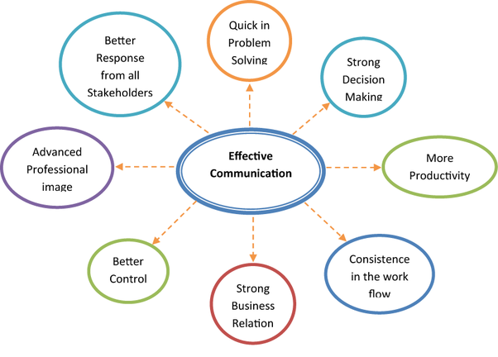
Communication & Well-Being
Group Discussion:
What does Well-Being mean to you?
How is Well-Being connected to successful communication?
Ways to improve my Well-Being that will improve my communication skills:

Slide 19
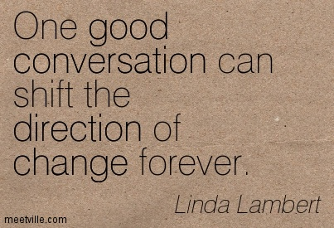
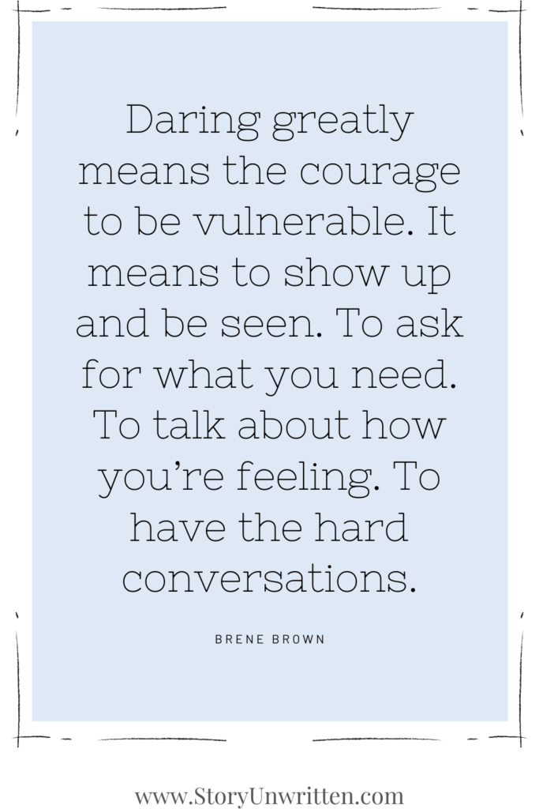

Slide 20
GTA’s: What was most valuable for you today?

