Slide 1
Coping with COVID
Let’s Move Forward Together
Created by Igniting Success, ©

Slide 2
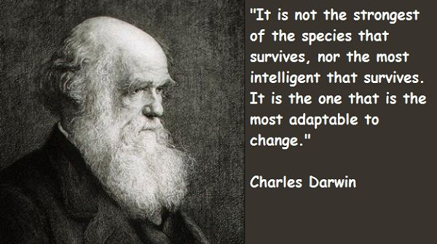

Slide 3
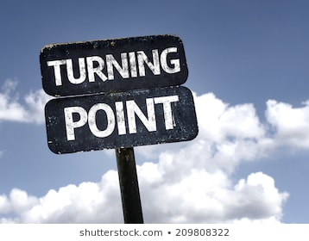
Phases of COVID:
Shock!
Uncertainty
Turning Point
Moving Forward
Repeat!
Everyone will have their own unique journey through these stages, and we are all likely to be at different places at different times.

Slide 4
Brief Overview of the Phases:
Shock! What the heck just happened? This can’t be true! Denial
Uncertainty: Feeling insecure, unsure, fearing the unknown, confusion
Turning Point: Point in time when something happens that causes a mental shift
Moving Forward: Stepping forward into new normal
Repeat!
Discussion: Where are you right now?
4

Slide 5
5 Phases of the Change Journey:
Awareness
Comprehension
Acceptance
Commitment
On Board

Slide 6
1. Awareness: Aware change is coming. Change is first announced. Choice: Anxiety or Excitement

Slide 7
2. Comprehension: Hits us personally, Understanding of what is really happening. Choice: Skepticism or Learning
Communication is Key!

Slide 8
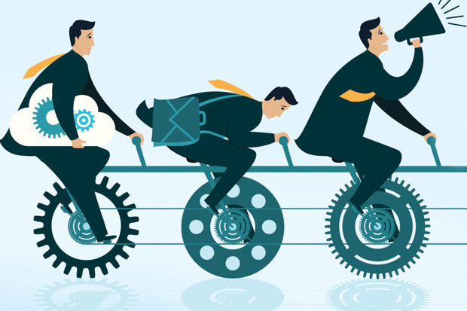
3. Acceptance: Just before acceptance, we hit the “valley of despair”, realize this is the way it is going to be. Choice: Performance & Productivity can turn around if we have strong Self-Awareness

Slide 9
4. Commitment: Proficiency increases, feel more comfortable doing things in the new way. Choice: Innovation & Accomplishment.

Slide 10
5. On Board: Conscious decision to commit to the change. Demonstrates excitement & positivity about change, becomes an advocate/ambassador for change initiative. Choice: Commitment to change and moving forward.

Slide 12
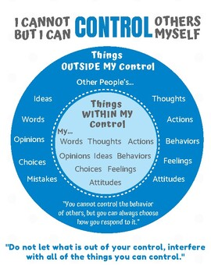

Slide 13
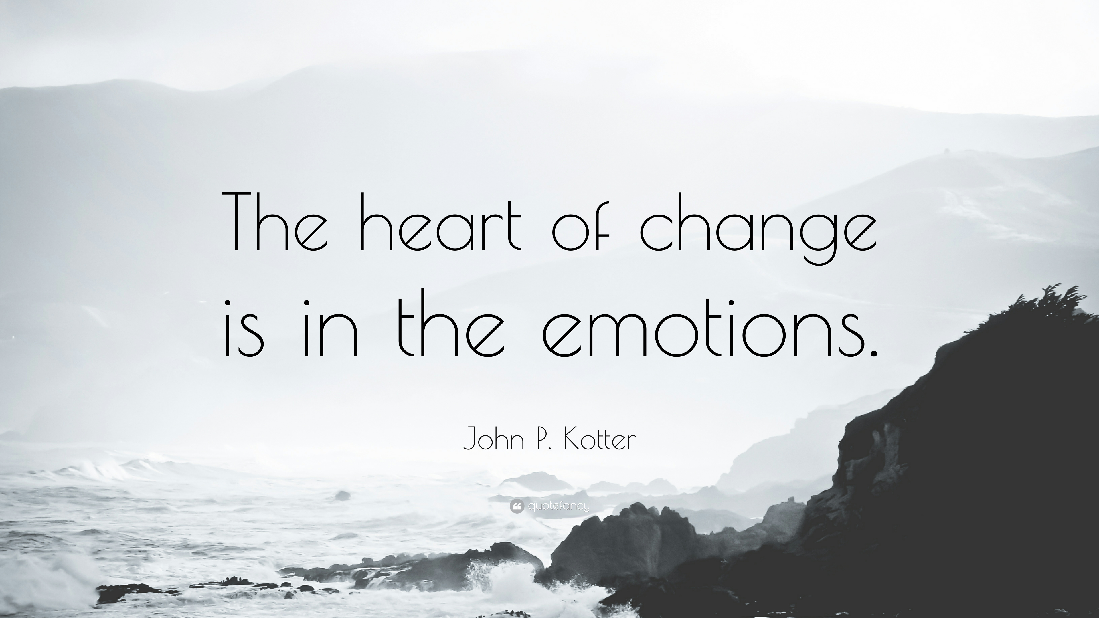

Slide 14
The Change Journey – 5 Key Phases
(Adapted from William Bridges Transition Model)
Uncertainty
Turning Point
Moving Forward
5. Onboard
1. Awareness
4. Commitment
+
Performance
-
2. Comprehension
3. Acceptance
14

Slide 15
The Change Journey – What we feel/experience (Adapted from William Bridges Transition Model)
Uncertainty
Turning Point
Moving Forward
Creativity
Innovation
5. Onboard
1. Awareness
Learning
High Energy
Excitement
4. Commitment
Accomplishment
Anticipation
2. Understanding
Relief
Performance
Confusion
FEAR
Anxiety
Skepticism
Stress
Denial
3. Acceptance
Frustration
Ambivalence
15

Slide 16
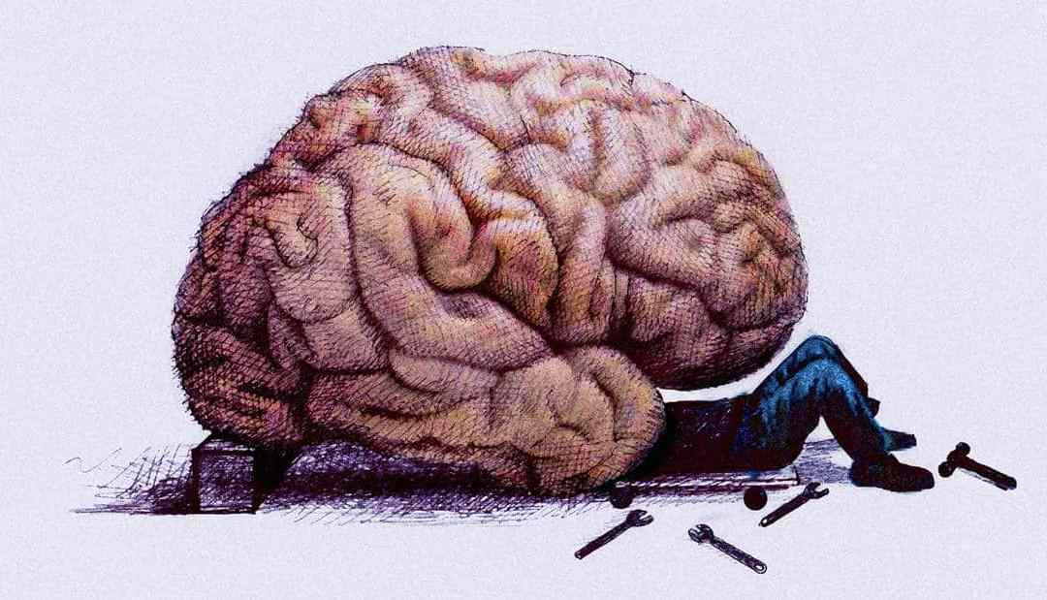
This is your brain on change…

Slide 17
The Change Journey - Neuroscience (Adapted from William Bridges Transition Model)
Uncertainty
Turning Point
Moving Forward
5. Onboard
1. Awareness
4. Commitment
2. Comprehension
Performance
3. Acceptance
Parasympathetic Nervous System
Calm, Able to make decisions, Leadership with Confidence
Sympathetic Nervous System
Fight, Flight, Freeze
Resentment, Low Morale,
Low Productivity
17

Slide 18
The Change Journey - Overview (Adapted from William Bridges Transition Model)
Uncertainty
Turning Point
Moving Forward
Creativity
Innovation
5. Onboard
1. Awareness
High Energy
Learning
4. Commitment
Excitement
Accomplishment
Anticipation
2. Comprehension
Relief
Performance
Confusion
FEAR
Anxiety
Skepticism
Denial
Stress
3. Acceptance
Frustration
Ambivalence
Parasympathetic Nervous System
Calm, Able to make decisions, Leadership with Confidence
Sympathetic Nervous System
Fight, Flight, Freeze
Resentment, Low Morale, Low Productivity

Slide 19
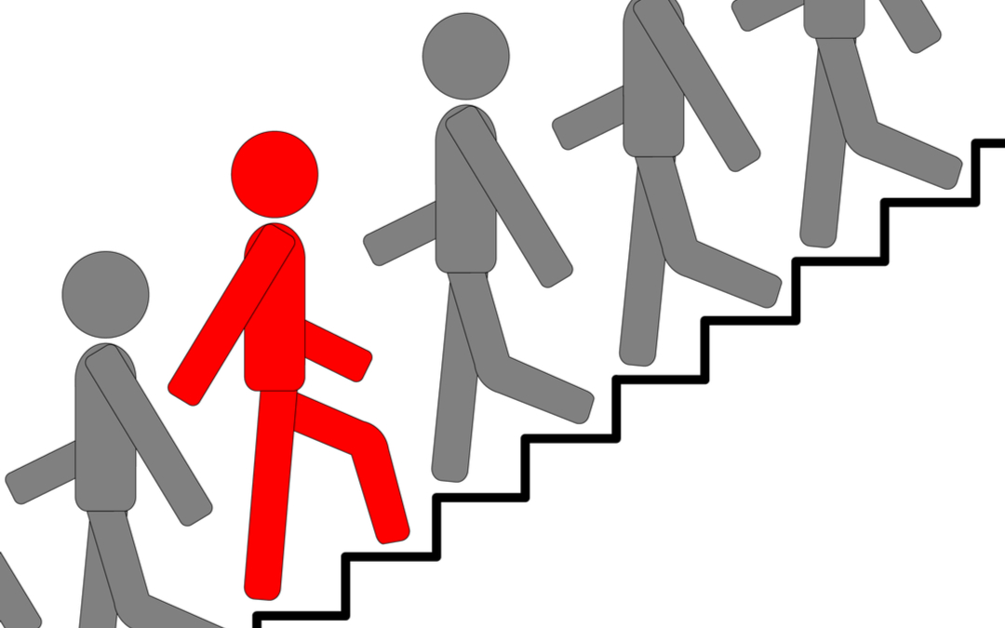
Group Discussion:
Where are you today?
Awareness
Comprehension
Acceptance
Commitment
Onboard

Slide 20
Questions!
Think about the information shared today – how can you use this information for yourself? At your organizations?
How can this information help you understand and/or support your co-workers?
How can this information help you serve work families and customers more effectively?

Slide 22
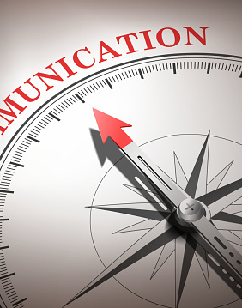
General Session: 5 Star Communication Handling Critical Conversations

Slide 23
Feel free to Reach Out to me:
Igniting Success
Website: www.margueriteham.com
303-646-2857 (US)
marguerite@ignitingsuccess.net
Certified ACC Organizational Coach (ICF Certification)
Certified Everything DISC Authorized Partner & Trainer
Created by Igniting Success, ©

